Slide 1




Acceptability and Affordability Testing
Quantitative Research – Full Report v1.0
18th September 2023
Photo by CDC on Unsplash

Slide 2

Content
2
1
Method
Context
Future bill affordability
Business plan components
Acceptability of proposed plans
Summary
2
3
4
5
6
Photo by CDC on Unsplash

Slide 3







Quantitative Methodology
3
 |  | Household | Non-household
 | Fieldwork dates | 18th July 2023 (full launch) to 13th August 2023. | 25th July to 4th September
 | Sampling | Randomly selected sample was drawn from the total customer database, within IMD quintile in proportions as prescribed by Ofwat Invitations were sent by email to those customers for whom an email address was held, and by letter to the remainder No reminders were sent as the response rate was sufficient to achieve the required target of survey completes without the need for reminders. | Three approaches were used: Telephone push to online: Dunn & Bradstreet business directory used to generate list of telephone numbers of organisations in each supply area. Numbers randomly called, in order to gather email address and send on email invitation to the survey Commercial online business-to-business panels: 5 panel partners were enlisted to provide online sample: Dynata, Bilendi, Pure Spectrum, Walr, Mindforce Emails sent to Retailers for distribution to end customers; however this did not yield any response.
 | Format | Online survey (link provided in emails and letters) plus printed versions provided upon request for those who could not complete online | Online survey only - link provided in email / via panels
 | Incentive | £5 Amazon or Love2Shop voucher | £25 Amazon voucher or £25 donation to Portsmouth Hospitals Trust (or standard panel incentives for B2B panellists)
 | Response rate | Across the three supply areas (after one reminder): c. 10% completion rate in response to email invitations c. 4% completion rate in response to letter invitations | Response rate to the telephone push to online approach was very low at c.0.5%, so online panels needed to be used for the large majority of surveys. No responses received to the retailer email send (which was left open until 11th Sept).
Exclusion criteria: Below a third of the median time of completion

Slide 4

Quantitative Method – Weighting
4
4
Data weighting was applied following Ofwat guidance
Five layers of weighting were applied based on the principle of representativeness:
  Age (based on Census data)
  Gender (based on Census data)
  Index of Multiple Deprivation (IMD) quintile (based on customer postcode data)
  Overall proportions of household : non household (based on overall water use - 2022-3 actual)
  Geographic representation into 5 groupings of postcodes (based on postcode distribution in customer database)
To achieve the targets, rim weighting was applied via specialist survey data processing software (Merlin)
A technical weighting report is available separately
Key outputs of the weighting report are:
  Overall unweighted base size: 715
  Overall effective weighted sample size: 661
  Min weight: 0.58
  Max weight: 2.10
Notes:
Email reminders sent on 28th July. Letter reminders sent on 7th August

Slide 5
Quantitative Method – adherence to the Ofwat guidance
5
5
Sample & method
Ofwat guidance on the prescribed sample & method was followed
As the research was joint research between Portsmouth Water and Southern Water, household customer records went through a matching process at the outset, in order to include bill amounts for both companies in the survey
  All household customers who were sent invitations were therefore billed customers of both Portsmouth Water and Southern Water, and as such no ‘single service’ customers who only pay one of the two companies were included
Optional reminders to household customers were not sent as there was a stronger response rate than expected, and reminders were not necessary to achieve the required target of n=500 survey completes
Questionnaire
Ofwat guidance (Appendix F) was followed for the questionnaire with some minor changes:
Included additional age band questions, to be inclusive of household customers who did not wish to write in their age (agreed by Ofwat)
Small wording edits to adapt the questionnaire for joint company research. This was to clarify which company was being referred to in questions on bill profile and plan acceptability (making clear where the question was referencing both water supply and sewerage services from both companies, and where just one company’s service was being referenced)
Optional questions included towards the end of the questionnaire to ask affordability specifically of Portsmouth Water bill profile and Southern Water bill profile separately. This was in addition to combined bill affordability (for both companies added together) near the beginning of the questionnaire (Q5).
Printed versions of the questionnaire needed additional signposting and minor wording edits for routing / navigation.
Quality Control & Analysis
According to guidance ‘speeders’ were removed from the reported data (completing the survey in under one third of median time for that respondent group).
  Note this could not be applied to the small number of respondents (n=6) who completed the printed version of the questionnaire
Ofwat guidance was followed on weighting, full details provided on page 4

Slide 6



Method – Qualitative Research Phase (April - June 2023)
6
2 x 90min reconvened online focus groups
Stage 1: Participants to attend first 90 min focus group
Stage 2: Participants to attend second 90 min focus group
Stage 3: Participants to complete post-task survey and answer questions based on their personal bill projections
Micro NHH
8 x 1hr online video depth
Stage 1: Participants to go through pre-read pack and fill out pre-task survey
Stage 2: Participants to attend 1 x 1hr online depth
Stage 3: Participants to complete post-task survey and answer questions based on their personal bill projections
3 x 3hr face-to-face deliberative events
Stage 1: Participants to go through pre-read pack and fill out pre-task survey
Stage 2: Participants to attend 1 x 3hr event each in person
Stage 3: Participants to complete post-task survey and answer questions based on their personal bill projections
Larger NHH
8 x 1hr online video depth
Stage 1: Participants to go through pre-read pack and fill out pre-task survey
Stage 2: Participants to attend 1 x 1hr online depth
Stage 3: Participants to complete post-task survey and answer questions based on their personal bill projections

Slide 7

Household customer profile – weighted data
The data for household customers is weighted to age and gender based on ONS information, Index of Multiple Deprivation, and postal area.
Age
Gender
Ethnicity
Household Income (pre tax)
Social Grade
Vulnerability
S1. How old are you?. Q11. In which of the following ways do you identify? Q15. What is your ethnic group? Q16. Which of the following bands does your household income fall into from all sources before tax and other deductions? D6. Social Grade D7. VULNERABLE CUSTOMERS Base Household bill payers: Total (582) WEIGHTED % FIGURES ARE DISPLAYED and UNWEIGHTED BASE SIZES
Notes:
7
Checked

Slide 8
Non-household customer profile
The majority of non-household customers surveyed are SMEs. NHH data has not had any weighting applied given lack of known profile and small overall sample size, but characteristics are broadly in line with expected profile of Standard Industrial Classification.
Number of UK sites
Number of UK employees
Sector
Service use
Q18. How many sites in the UK does your organisation operate from?; Q19 How many employees does your organisation have in the UK?; Q20. Which of the following best defines the core activity of your organisation? Q17. How does your organisation mainly use water at its premises? Base Non-household bill payers: Total (133) WEIGHTED % FIGURES ARE DISPLAYED and UNWEIGHTED BASE SIZES
Notes:
8
Checked

Slide 9

Context
Photo by Josh Appel on Unsplash

Slide 10





Summary of the in-going customer view
10
One third of Portsmouth Water customers have struggled to pay at least one of their bills over the last year (bills in general, rather than water bills specifically), and the outlook is pessimistic for the future – 4 in 10 think things will get worse.
HH & NHH
HH
NHH
Struggled to pay bills in the last year (all/most/some of the time)
33%
28%
47%
Finding it quite or very difficult to manage financially
12%
12%
12%
Expect financial situation to get worse
40%
46%
18%
Q1. Thinking about your household’s /organisation’s finances over the last year, how often, if at all, have you struggled to pay at least one of your household/ it’s bills?; Q2. Overall, how well would you say you are managing financially now? Q3. Thinking about your household’s/organisation’s financial situation over the next few years up to 2030, do you expect it to get: Base Total Household and Non Household bill payers (715) Total Household bill payers (582) and Total Non Household bill payers (133) WEIGHTED % FIGURES ARE DISPLAYED and UNWEIGHTED BASE SIZES

Slide 11
A substantial minority are struggling financially with a pessimistic outlook on future finances
1 in 3 customers struggled to pay at least one of their bills in the last year, with 12% finding it ‘difficult’ to manage financially and a further 28% ‘just getting by’. 2 in 5 believe their financial situation will worsen over the next few years.
How often struggled to pay your bills in the last year?
How well managing financially now?
Expect financial situation to get...?
Rarely / never
63%
33%
Comfortable / alright
55%
12%
Better
26%
40%
All / most / some of time
Quite / very difficult
Worse
Q1. Thinking about your household’s /organisation’s finances over the last year, how often, if at all, have you struggled to pay at least one of your household/ it’s bills?; Q2. Overall, how well would you say you are managing financially now? Q3. Thinking about your household’s/organisation’s financial situation over the next few years up to 2030, do you expect it to get…?
Base Household and Non household bill payers: Total (715); WEIGHTED % FIGURES ARE DISPLAYED and UNWEIGHTED BASE SIZES
Notes:
11
Checked

Slide 12

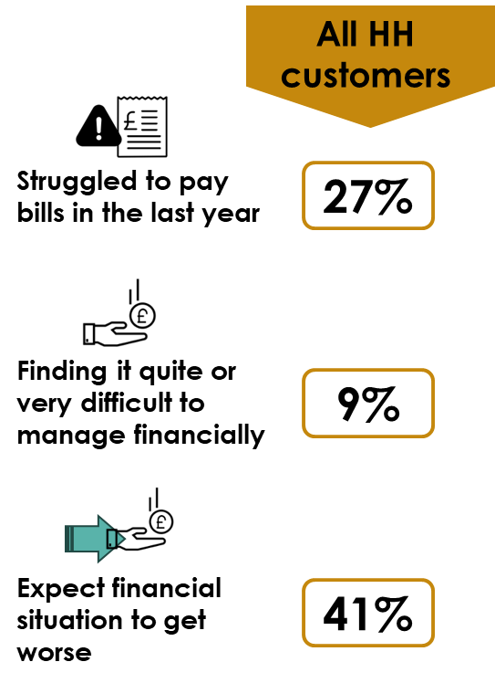

Current financial situation – Qualitative insight
Financial situation summary from Quantitative data
The qualitative stage of research (in May 2023) also showed a financially challenging picture – indicatively even more pessimistic than seen in the quantitative research
In the qualitative research:
  The majority of the sample (20/34) said they fell somewhere between ‘just getting by’ and ‘struggling’ when it comes to household finances
  Most (25/34) thought that the current economic situation was worsening.
Qualitative insights (focus on household customers)
28%
“It feels better but that’s simply because it’s summer and our heating is off. As next winter comes round it will be just as bad if not worse”
HH Bognor
“It’s hard and getting harder constantly going up and up, really big increases in a short space of time causing stress in the household and impacting our behaviour”
HH Portsmouth
“The banks have raised their interest rates again for the 12th time running – it just puts strain on everybody and everything.”
HH Portsmouth
12%
46%
“Salaries are not going up accordingly so everyone wants to strike.”
HH Portsmouth
“Prices have gone up so quickly but they are so slow to come back down” HH Portsmouth
Q2 / Q3 / Q4
Base Household bill payers (582)
Notes:
12
Checked

Slide 13
Current water & sewerage bill affordability
While more customers find their current water & sewerage bills easy to afford than find them difficult to afford, many also say it is ‘neither easy nor difficult’. Those who are finding it difficult tend to be lower income & lower social grade – but it is not exclusively these customers.
How easy or difficult to afford current water & sewerage bills?
Bill Affordability – Household subgroup differences
% of each group who think it will be difficult to afford
Easy to afford | 45% | 44% | 50%
Difficult to afford | 12% | 10% | 20%
Total HH
Vulnerability
Financially managing
Gender
Social Grade
In addition, customers of non-white ethnicity are much more likely to find it difficult – 35% vs. 9% of white ethnicity
Income
Water meter
Q4. How easy or difficult is it for you to afford to pay your/your organisation current water and sewerage bill? Base Total household and non-household bill payers (715); Total household bill payers (582); Total non-household bill payers (133).
WEIGHTED % FIGURES ARE DISPLAYED and UNWEIGHTED BASE SIZES
Notes:
13
Checked

Slide 14

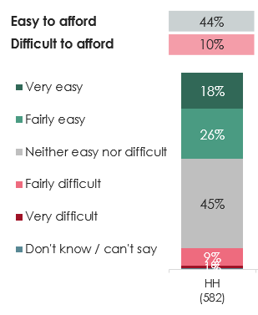
Current water & sewerage bill affordability – Qualitative context
How easy or difficult to afford current water and sewerage bill?
Quantitative data for HH customers
In terms of the affordability of current water and sewerage bills, the earlier qualitative research painted a similar picture to the quantitative research:
  A minority of the qualitative of household customers (5/29) found it difficult to pay their current water and sewerage bills
The conversations showed that some people were making sacrifices to be able to afford bills.
Qualitative insights
“I haven’t used the boiler or immersion since the prices started going up.”
Economically vulnerable Portsmouth
“Being retired I’m finding that I am dipping into my savings more and more to meet the bills basically.”
HH Portsmouth
Q4 How easy or difficult is it for you to afford to pay your current water and sewerage bill?
Base HOUSEHOLD bill payers (582)
Notes:
14
Checked

Slide 15

Future bill affordability for business plan
Photo by rupixen.com on Unsplash

Slide 16
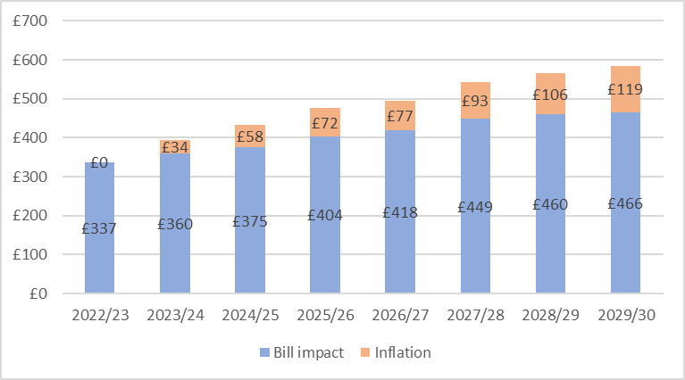
Bill Impact affordability – stimulus shown
Household customers were shown the bill increases for 2022-23 to 2029-30, based on their current annualised bills.
Non-household customers were shown the bill increases for 2022-23 to 2029-30, based on an example bill for 2022-23.
The bill is split into the proposed costs to cover the investments in water services, and predicted inflation (in orange).
Customers were asked about three proposed bill profiles:
Combined water supply and sewerage services bills (Portsmouth Water and Southern Water bills)
Water supply bills only (Portsmouth Water)
Sewerage service bills only (Southern Water)
Example personalised bill profile shown
Notes:
16
Note: For Portsmouth only add: This exercise was repeated for the bill impact attributed to water supply services only and again for sewage services only services (an additional exercise beyond what was prescribed by Ofwat).

Slide 17
Over 4 in 10 say that they will find the proposed combined water and sewerage bills difficult to afford – a very substantial increase over how many say today’s bills are difficult to afford.
17
Lowest income households, lower social grade, and households who do not feel ‘comfortable or alright’ financially are more worried about being able to afford – underlining the need for development of appropriate bill support.
Affordability of water & sewerage bills up to 2029-30
Bill Affordability to 2029-30 – Household subgroup differences
% of each group who think it will be difficult to afford
Easy to afford | 19% | 14% | 38%
Difficult to afford | 44% | 47% | 34%
Total HH
Vulnerability
Financially managing
Gender
Social Grade
Income
Water meter
Q5. How easy or difficult do you think it would be for you to afford these water and sewerage bills?
Base Total household and non-household bill payers (715); Total household bill payers (582); Total non-household bill payers (133). WEIGHTED % FIGURES and UNWEIGHTED BASE SIZES are displayed

Slide 18
Just under 1 in 5 feel that future water & sewerage bills will be easy to afford.
18
18
Household customers are less likely to feel that the water & sewerage bills are easy to afford than-non households, even amongst those in more comfortable financial situations.
Affordability of water & sewerage bills up to 2029-30
Bill Affordability to 2029-30 – Household subgroup differences
% of each group who think it will be easy to afford
Easy to afford | 19% | 14% | 38%
Difficult to afford | 44% | 47% | 34%
Total HH
Vulnerability
Financially managing
Gender
Social Grade
Income
Water meter
Q5. How easy or difficult do you think it would be for you to afford these water and sewerage bills?
Base Total household and non-household bill payers (715); Total household bill payers (582); Total non-household bill payers (133). WEIGHTED % FIGURES and UNWEIGHTED BASE SIZES are displayed

Slide 19

Proposed plan bill affordability – Qualitative context
Affordability of water & sewerage bills up to 2029-30
(Total households)
Qualitative insights
In the qualitative research, almost half (23/51) were on the fence about affordability of the water and sewerage bills in future. 16/51 said it would be unaffordable, and 10/51 said it would be affordable.
There was shock around the overall bill impact, and the inflation was more significant than expected, though recognised as an unknown.
Easy to afford | 14%
Difficult to afford | 47%
“This is scary especially when people are struggling and there are mental health challenges”
HH Portsmouth
“This is too much, we can’t afford it. It will put people in poverty”
HH Portsmouth
“Inflation could come down. Pigs might fly!”
HH Portsmouth
Q5 How easy or difficult do you think it would be for you to afford these water and sewerage bills?
Base HOUSEHOLD bill payers (582)
Notes:
19
Checked

Slide 20
How would customers pay for increased water bills between 2025 and 2030
The most widespread way of paying higher bills is to reduce discretionary spend, but many would need to limit spend on day-to-day essentials like food, gas and water. Those struggling financially more likely to cut back on essentials, as well as using credit and asking family.
Which of the following would you need to do to pay for the water bill increases between 2025 and 2030?
(Household customers who would not find it easy to pay the proposed water and sewerage bills)
Q6. Which of the following do you think you would need to do to pay for the increase in your water bills between 2025 and 2030?
Base: All household customers who do not think it is easy to afford the proposed water and sewerage bills (478)
WEIGHTED % FIGURES ARE DISPLAYED and UNWEIGHTED BASE SIZES
Notes:
20
Checked

Slide 21
Preferred phasing of water bill increase
There is a preference for the bill increasing sooner rather than later, though four in ten give no opinion either way.
Which of the following options would you prefer?
Total HH & NHH (715) | Household only (582) | Household vulnerable (228) | Household struggling (68) | Non household (133)
Q9. Long term investment by Portsmouth Water/Southern Water will require an increase in customer bills. Bills could increase in different ways over time. For example, there could be increases now for current bill payers, or bigger increases in the long term for future generations. Which one of the following options would you prefer? Base Total Household and Non household bill payers: (715)
WEIGHTED % FIGURES ARE DISPLAYED and UNWEIGHTED BASE SIZES
Notes:
21
Checked

Slide 22
Focusing just on the water supply service bill profile for Portsmouth Water, 1 in 4 HH customers say this would be easy to afford, and 28% think it would be difficult to afford.
22
Lowest income households, lower social grade, and those who do not feel ‘comfortable’ financially are more worried about affording – but concern is lower than it is for combined water & sewerage bills.
Affordability of water only bills up to 2029-30
Bill Affordability to 2029-30 – Household subgroup differences
% of each group who think it will be difficult to afford
Easy to afford | 28% | 25% | 40%
Difficult to afford | 29% | 28% | 33%
Total HH
Vulnerability
Financially managing
Age
Gender
Social Grade
Income
Water meter
Q5b How easy or difficult do you think it would be for you/your organisation to afford these water bills for the water services provided by Portsmouth Water? Base Total household and non-household bill payers (715); Total household bill payers (582); Total non-household bill payers (133). WEIGHTED % FIGURES and UNWEIGHTED BASE SIZES are displayed

Slide 23

Business plan components
Photo by micheile henderson on Unsplash

Slide 24
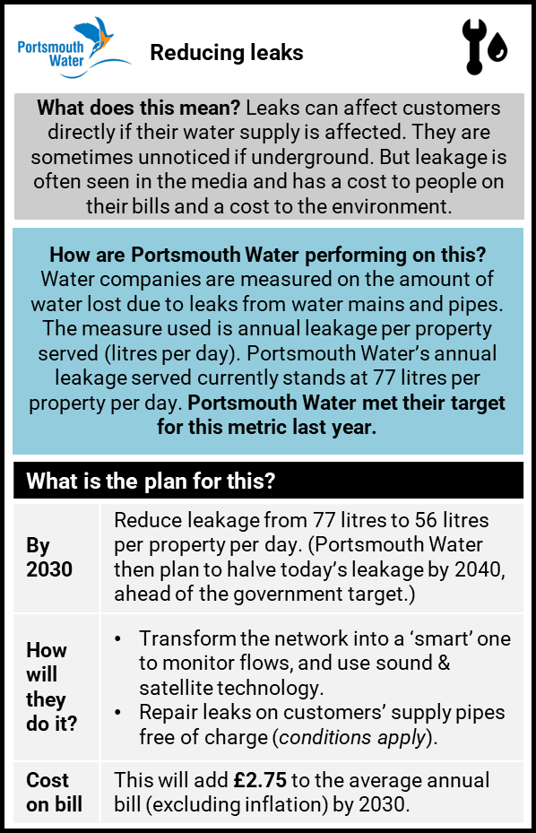
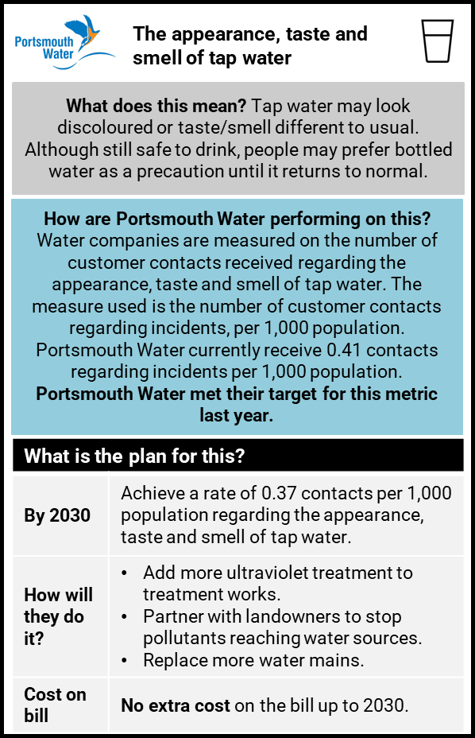

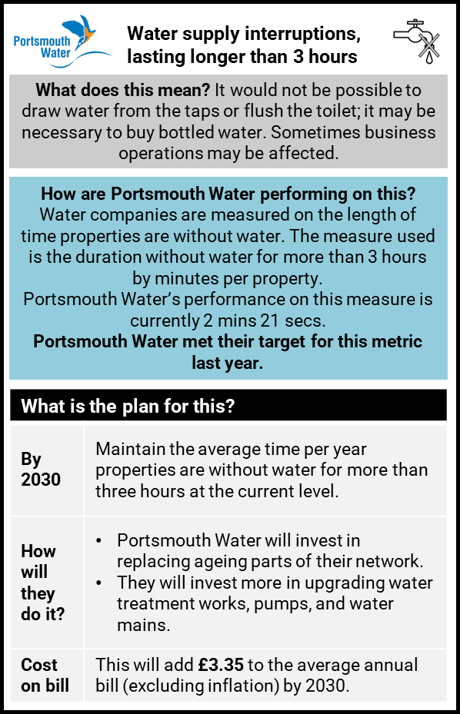


Water supply Performance Commitments – Importance
Reducing leaks is voted the most important of the water supply PCs overall, although those struggling financially place slightly greater importance on water quality. Water supply interruptions were most important to a quarter of NHH customers.
For detailed stimuli shown to respondents, please see Appendix
Which of these three parts of the business plan is the most important to you: Common Performance Commitments (Water)
Q7a. Based on what you have just read, which of these three parts of the business plan is the most important to you? Base Total household and non-household bill payers (715) WEIGHTED % FIGURES ARE DISPLAYED and UNWEIGHTED BASE SIZES
Notes:
24
Checked

Slide 25
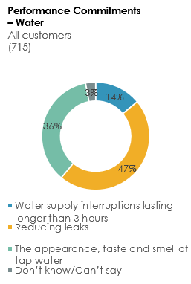
Water supply Performance Commitments – Qualitative Insight
Which of these three parts of the business plan is the most important to you?
Quantitative data
Qualitative insights based on deliberative discussions
Supply interruptions: Not seen as an area needing big improvement.
6 seconds over 7 years seen as not ambitious enough, with some questioning what the 67p is paying for given there is little change.
Reducing leaks: There was surprise at the level of leakage – and it was seen as a priority for improvement
Some question the ambition of the target: 56 l/p/d…why not lower – or even zero?
Appearance, taste and smell of tap water: No existing concerns about water quality, and customers expect Portsmouth Water to maintain high quality water.
Happy with target and no bill impact.
“They are the best in the country and leading by example whilst also the cheapest. So 67p is fair if they maintain standards.”
HH Portsmouth
“I think 55p a day is OK. It’s only going to get worse if they don’t do anything about it.”
HH Portsmouth
Notes:
25
Checked

Slide 26
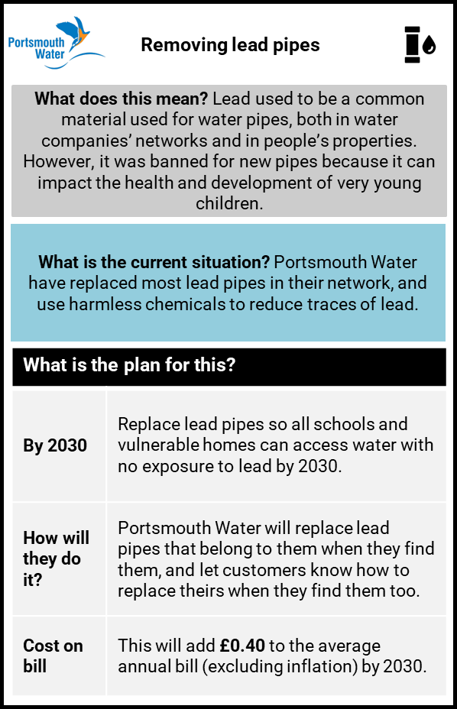
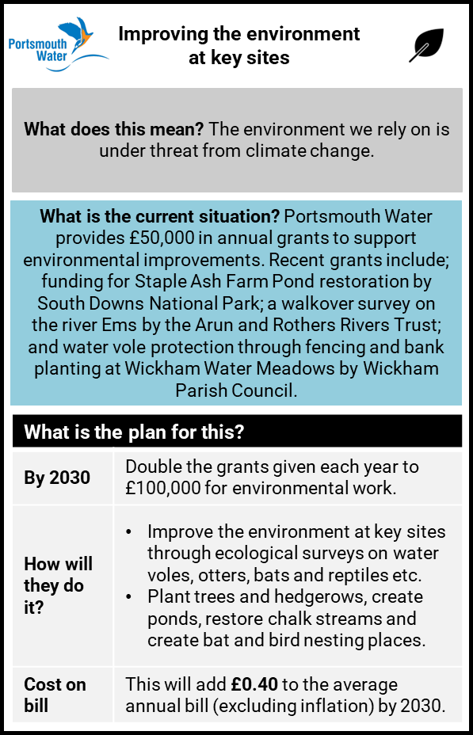

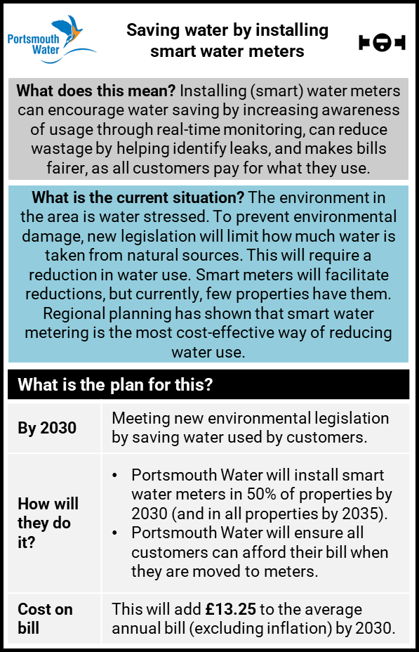


Additional water supply plan components – Importance
All customers groups rated the replacement of lead pipes the most important of the three additional water supply plan components, while installing smart meters was deemed the least important.
For detailed stimuli shown to respondents, please see Appendix
Which of these three parts of the business plan is the most important to you: Additional Plan Components (Water)
Q7b. Based on what you have just read, which of these three parts of the business plan is the most important to you?
Base Total household and non-household bill payers (715) WEIGHTED % FIGURES ARE DISPLAYED and UNWEIGHTED BASE SIZES
Notes:
26

Slide 27
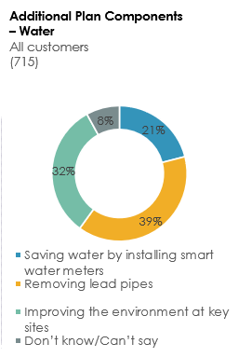
Additional Plan Components (water) – Qualitative Insight
Which of these three parts of the business plan is the most important to you?
Quantitative data
Qualitative insights based on deliberative discussions
Installing smart water meters: there were questions about how smart meters work, and some resistance from non-metered households, as well as anxiety from economically vulnerable people and families about charges. Those with low water usage were most enthusiastic.
Replacing lead pipes: There were pockets of awareness about the issue and mixed views about its urgency.
Some want a more ambitious target.
Seen as a big programme reaching every affected property – but is there more to be done to identify affected properties?
Improving the environment at key sites: There was support for environmental targets.
“Smart meters seem the fairest way as you are paying for your use – but I’m always cautious of anything using the word smart.”
HH Bognor
“It leaves the door open for them to charge you every little morsel of water.” Economically vulnerable Bognor
Notes:
27
Checked

Slide 28

Acceptability of proposed plans

Slide 29
Acceptability - Summary
HH & NHH
HH
NHH
Overall plans – acceptable
In response to seeing both Portsmouth Water and Southern Water plans
61%
57%
77%
Portsmouth Water’s proposed plan for water supply services – acceptable
76%
75%
80%

Slide 30

Acceptability of the combined business plans (referencing both Portsmouth Water’s and Southern Water’s plans) is 61% overall; slightly lower at 57% for households specifically.
30
There is not huge variation in acceptability by various demographic groups.
Acceptability of the overall plans (PW and SW plans)
Plan Acceptability– Household subgroup differences
% of each group who think it is completely acceptable or acceptable
Acceptable | 61% | 57% | 77%
Unacceptable | 26% | 28% | 19%
Total HH
Vulnerability
Financially managing
Gender
Social Grade
Income
Water meter
Q8. Based on everything you have seen and read about the proposed business plan, how acceptable or unacceptable is it to you? Base Total household and non-household bill payers (715); Total household bill payers (582); Total non-household bill payers (133)
WEIGHTED % FIGURES ARE DISPLAYED and UNWEIGHTED BASE SIZES
Notes:
30

Slide 31
Just over a quarter of all customers find the overall plans (referencing both Portsmouth Water’s and Southern Water’s plans) unacceptable. This is a similar picture to that seen in the qualitative.
31
There is not huge variation in levels of unacceptability in HH demographic subgroups – although men and ABC1 social grade customers are slightly more likely to oppose the plans.
Acceptability of the overall plans (PW and SW plans)
Plan Unacceptability – Household subgroup differences
% of each group who think it is completely unacceptable or unacceptable
Acceptable | 61% | 57% | 77%
Unacceptable | 26% | 28% | 19%
Total HH
Vulnerability
Financially managing
Age
Gender
Social Grade
Income
Water meter
Q8. Based on everything you have seen and read about the proposed business plan, how acceptable or unacceptable is it to you? Base Total household and non-household bill payers (715); Total household bill payers (582); Total non-household bill payers (133)
WEIGHTED % FIGURES ARE DISPLAYED and UNWEIGHTED BASE SIZES
Notes:
31

Slide 32

Those accepting the overall combined Portsmouth Water and Southern Water plans support what the companies are trying to do and think they are focusing on the right services.
32
A significant proportion also say that while they have been dissatisfied, they are pleased to see the companies making improvements; this was largely with Southern Water in mind.
Reasons for accepting the overall plans (PW and SW plans)
(Household and Non household customers who found the plans acceptable)
Qualitative insights based on deliberative discussions
Most, on further consideration, want to see this level of investment
Strong support for Southern Water improvements as these are seen as critical – but with shorter term goals and faster results. But trust deficit creates cynicism about the customers’ role in paying for past neglect/under investment
“It’s 40p per week to maintain supply that works and a sewer system that doesn’t… if 40p fixes the sewage issues then it is worth it.”
HH Bognor
“it is good for our environment and the community. It’s acceptable!”
NHH Bognor
“I would rather pay £1 and bring it down 50%”
HH Bognor
“I think 55p a day is OK. It’s only going to get worse if they don’t do anything about it.”
HH Portsmouth
A8b. What are the two main reasons that you feel the proposals for your water services are acceptable?
Base Household and Non household bill payers who found the plan acceptable (434). WEIGHTED % FIGURES ARE DISPLAYED and UNWEIGHTED BASE SIZES
Notes:
32

Slide 33

Those not accepting the overall combined Portsmouth Water and Southern Water plans say this is because profits are too high, they don’t trust them to improve, and companies should pay.
33
There is indicative evidence that customers making these comments primarily have Southern Water in mind, particularly in terms of profits being too high and not trusting them to make service improvements.
Reasons for not accepting the overall plans (PW and SW plans)
(Household and Non household customers who found the plans unacceptable)
Qualitative insights based on deliberative discussions
Shock around the overall bill impact (combination of water and sewerage services)
Southern Water’s poor past performance leaves doubt about their ability to deliver the outcomes
While individual elements felt affordable the example based on average bills creates some disquiet.
“This is scary especially when people are struggling and there are mental health challenges”
HH Portsmouth
“This is too much, we can’t afford it. It will put people in poverty”
HH Portsmouth
“Inflation could come down. Pigs might fly!”
HH Portsmouth
A8a. What are the two main reasons that you feel the proposals for your water services are unacceptable? Base: Household and non-household bill payers who find the plan unacceptable or completely unacceptable (187)
WEIGHTED % FIGURES ARE DISPLAYED and UNWEIGHTED BASE SIZES
Notes:
33

Slide 34
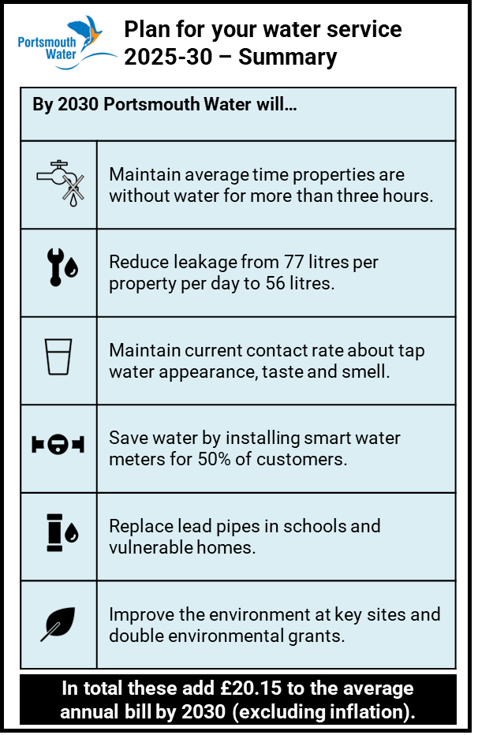
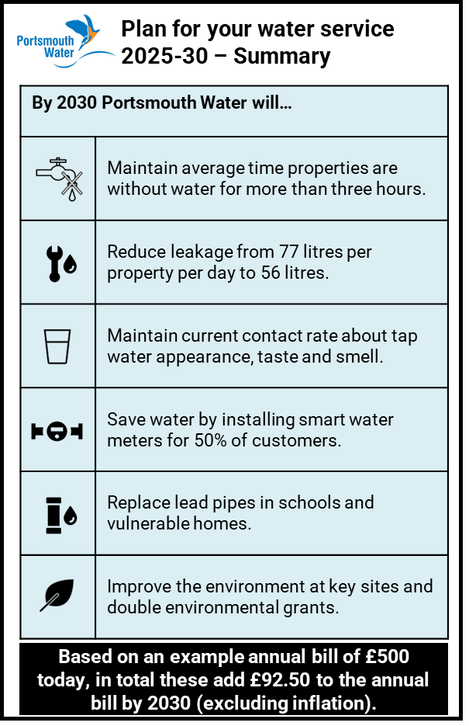
Acceptability of proposed plan for water supply services
Focusing just on Portsmouth Water’s plans for water supply services, acceptability is much higher: Three quarters of household customers find Portsmouth Water’s plans acceptable, and 8 in 10 non household customers. Struggling households least accepting.
For detailed stimuli shown to respondents, please see Appendix
How acceptable or unacceptable is Portsmouth Water’s proposed plan for water supply services?
Net: Acceptable
76% | 75% | 77% | 66% | 80%
16% | 16% | 15% | 19% | 17%
Net: Unacceptable
Summary shown to household customers
Summary shown to non-household customers
Q10a. Based on everything you have seen and read about Portsmouth Water’s proposed business plan for water supply services, how acceptable or unacceptable is it to you? Base: Total household and non-household bill payers (715); WEIGHTED % FIGURES ARE DISPLAYED and UNWEIGHTED BASE SIZES
Notes:
34
Checked

Slide 35
Focusing just on Portsmouth Water’s plan for water services, there is not a great deal of variation in acceptability amongst different demographic groups.
35
The least accepting are those who are finding it difficult to manage financially (‘struggling’ households).
How acceptable or unacceptable is Portsmouth Water’s proposed plan for water supply services?
Plan Acceptability– Household subgroup differences
% of each group who think it is completely acceptable or acceptable
Plan Unacceptability – Household subgroup differences
% of each group who think it is completely unacceptable or unacceptable
Total HH
Total HH
Vulnerability
Vulnerability
Financially managing
Financially managing
Age
Gender
Gender
Social Grade
Social Grade
Income
Income
Water meter
Water meter
Q10a. Based on everything you have seen and read about Portsmouth Water’s proposed business plan for water supply services, how acceptable or unacceptable is it to you? Base: Total household bill payers (582); WEIGHTED % FIGURES ARE DISPLAYED and UNWEIGHTED BASE SIZES
Notes:
35

Slide 36

Summary
Photo by Nick Fewings on Unsplash

Slide 37
Summary | Vital statistics
Easy to afford bill now
Would be easy to afford future bill
Plan Acceptability

Slide 38
Executive Summary
38
1
The current financial situation is important context in interpreting the results of this research: Only a minority of customers feel that they are ‘comfortable’ financially, and the outlook is pessimistic.
2
Despite the financial squeeze, only a minority (12%) find it difficult to afford their current water & sewerage bills. However, when presented with proposed future bills (combining Portsmouth Water and Southern Water bills), the proportion who say they will find it difficult to afford increases to over 4 in 10.
3
Considering only the proposed water supply bill for Portsmouth Water, the proportion who say it will be difficult to afford is lower – at 29% - while 28% say it would be easy to afford. Notably a high proportion (over 4 in 10) do not give an opinion either way.
4
Acceptability of the proposed business plan specifically for Portsmouth Water stands at 76% overall
75% of household customers find it acceptable, dropping to 66% of HH customers who are struggling financially
Acceptability is directionally slightly higher amongst NHH customers, at 80%.
5
The element of Portsmouth Water’s plans that raises the most questions is smart water meters. ‘Installing smart water meters’ is the non-performance commitment part of the plan which fewest customers think is ‘most important’ . Drawing on the qualitative stage of research, there were questions about how smart meters work, and some resistance from non-metered households, as well as anxiety from economically vulnerable people and larger households.
6
Lack of acceptance of the combined plans for Portsmouth Water and Southern Water revolve around issues of company profits and a lack of trust. There are indications that these sentiments largely reflect feelings about Southern Water rather than Portsmouth Water.

Slide 39

Appendix
Photo by Luis Tosta on Unsplash

Slide 40


Appendix 1 – Additional data by key groups

Slide 41
Current financial situation
How well managing financially now?
Net: Comfortably/well/
alright/getting by
83%
12%
82%
12%
79%
15%
100%
0%
86%
12%
Net: Quite /very difficult
Total HH & NHH (715) | Household only (582) | Household vulnerable (228) | Household struggling (68) | Non household (133)
Q2. Overall, how well would you say you are managing financially now? Base Total Household and Non household bill payers: (715)
WEIGHTED % FIGURES ARE DISPLAYED and UNWEIGHTED BASE SIZES
Notes:
41
Checked

Slide 42
Expected financial situation
Expect financial situation to get...?
Net: Better
25%
40%
19%
46%
12%
52%
29%
59%
48%
18%
Net: Worse
Total HH & NHH (715) | Household only (582) | Household vulnerable (228) | Household struggling (68) | Non household (133)
Q3. Thinking about your household’s/organisation’s financial situation over the next few years up to 2030, do you expect it to get: Base Total Household and Non household bill payers: (715)
WEIGHTED % FIGURES ARE DISPLAYED and UNWEIGHTED BASE SIZES
Notes:
42
Checked

Slide 43
Struggling financially
How often have you struggled to pay at least one of your household’s bills in the last year?
Net: Rarely/never
63%
32%
66%
28%
63%
30%
22%
78%
52%
47%
Net: All/most/some
Total HH & NHH (715) | Household only (582) | Household vulnerable (228) | Household struggling (68) | Non household (133)
Q1. Thinking about your household’s /organisation’s finances over the last year, how often, if at all, have you struggled to pay at least one of your household/ it’s bills? Base Total Household and Non household bill payers: (715)
WEIGHTED % FIGURES ARE DISPLAYED and UNWEIGHTED BASE SIZES
Notes:
43
Checked

Slide 44
Current bill affordability
How easy or difficult is it to afford to pay current water and sewerage bill?
Net: Easy
45%
12%
44%
10%
44%
9%
7%
45%
50%
20%
Net: Difficult
Total HH & NHH (715) | Household only (582) | Household vulnerable (228) | Household struggling (68) | Non household (133)
Q4. How easy or difficult is it for you to afford to pay your/your organisation current water and sewerage bill?
Base Total Household and Non household bill payers: (715)
WEIGHTED % FIGURES ARE DISPLAYED and UNWEIGHTED BASE SIZES
Notes:
44
Checked

Slide 45
Acceptability of overall plan (Portsmouth Water and Southern Water combined)
How acceptable is the overall plan?
Net: Acceptable
61%
26%
57%
28%
60%
26%
51%
26%
77%
19%
Net: Unacceptable
Total HH & NHH (715) | Household only (582) | Household vulnerable (228) | Household struggling (68) | Non household (133)
Q8. Based on everything you have seen and read about the proposed business plan, how acceptable or unacceptable is it to you? Base All household and non-household bill payers (715)
WEIGHTED % FIGURES ARE DISPLAYED and UNWEIGHTED BASE SIZES
Notes:
45
Checked

Slide 46
Appendix 2 – Survey stimuli

Slide 47

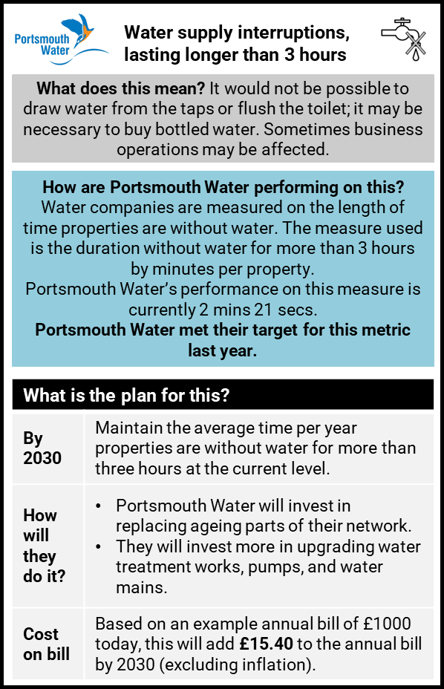
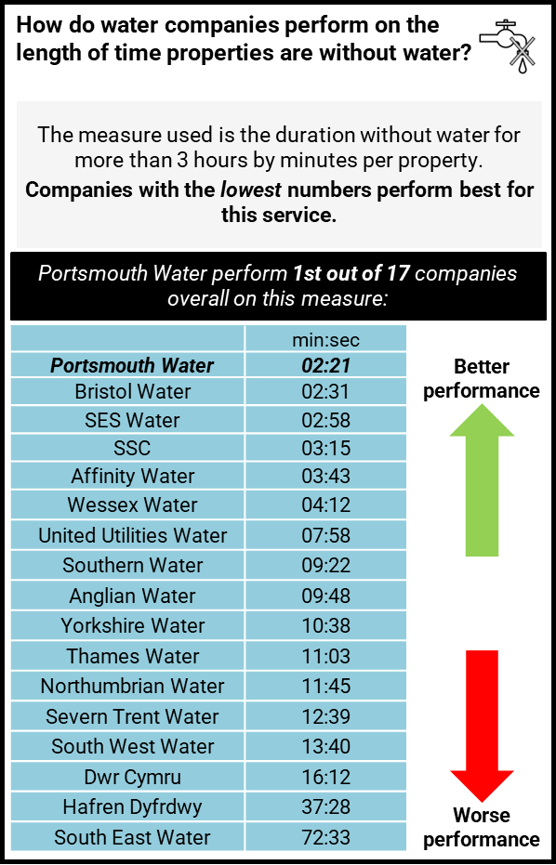
Water supply interruptions
STIM_1A_PortsmouthWater_Households
STIM_1A_PortsmouthWater_NonHouseholds
STIM_1B_PortsmouthWater_HH+NHH
Notes:
47
Checked

Slide 48

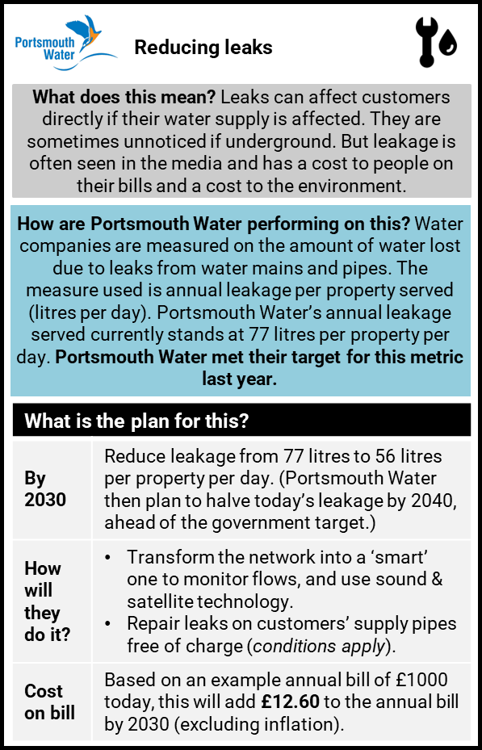
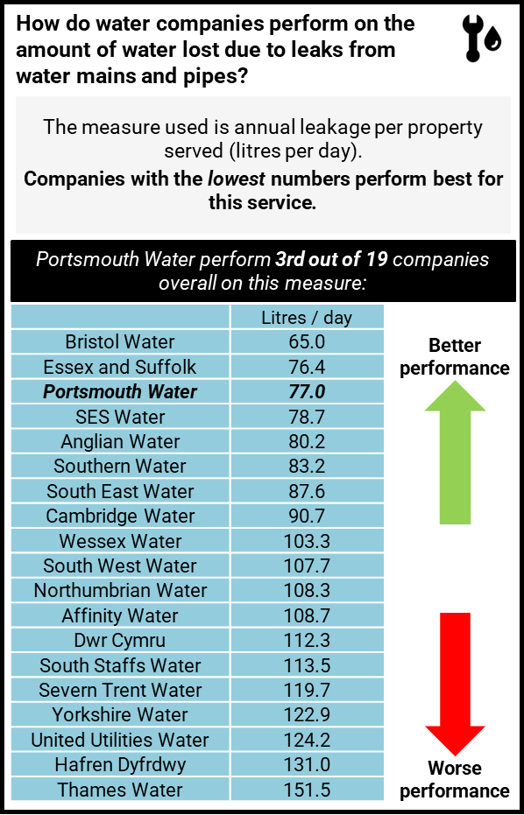
Reducing leaks
STIM_2A_PortsmouthWater_Households
STIM_2A_PortsmouthWater_NonHouseholds
STIM_2B_PortsmouthWater_HH+NHH

Slide 49


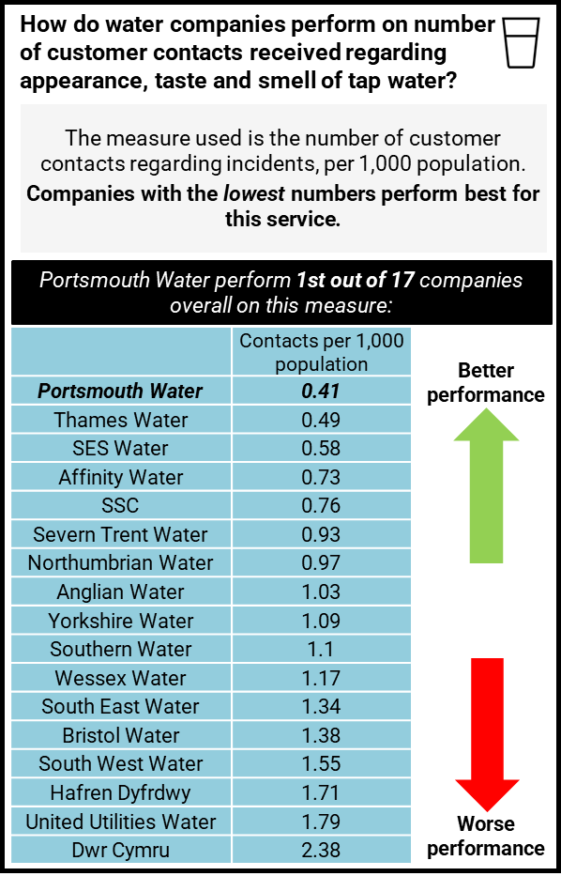
Appearance, taste and smell of tap water
STIM_3A_PortsmouthWater_Households
STIM_3A_PortsmouthWater_NonHouseholds
STIM_3B_PortsmouthWater_HH+NHH

Slide 50
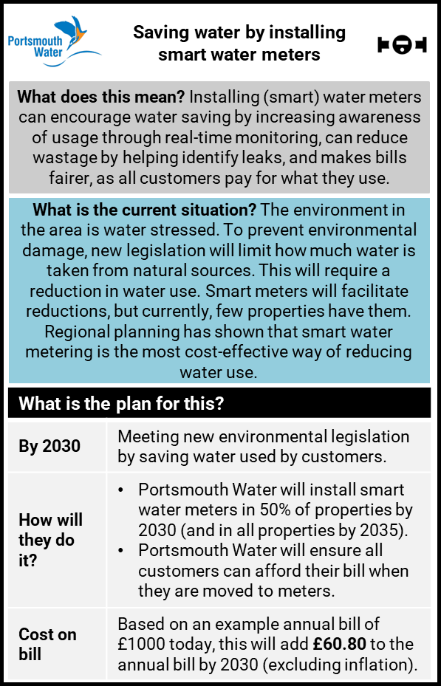
Saving water by installing smart water meters
STIM_4_PortsmouthWater_Households
STIM_4_PortsmouthWater_NonHouseholds

Slide 51
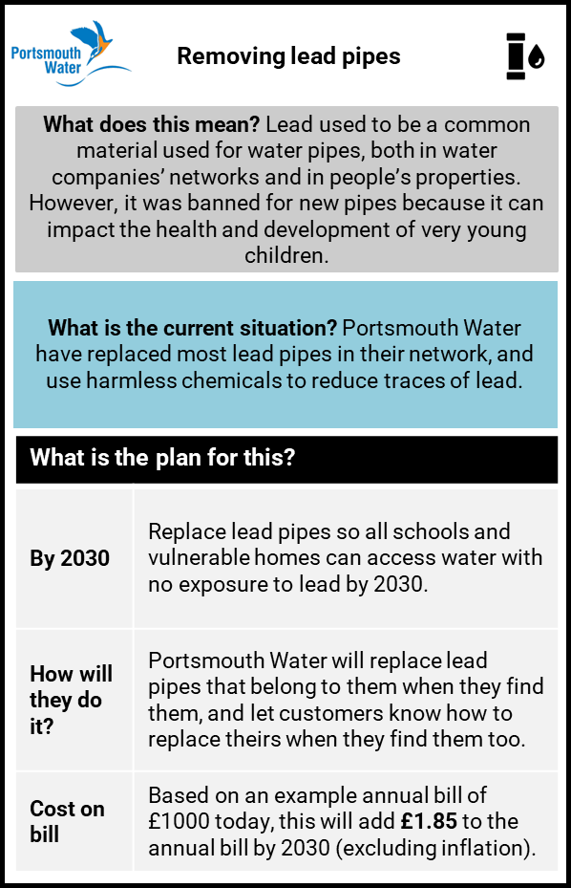
Removing lead pipes
STIM_5_PortsmouthWater_Households
STIM_5_PortsmouthWater_NonHouseholds

Slide 52
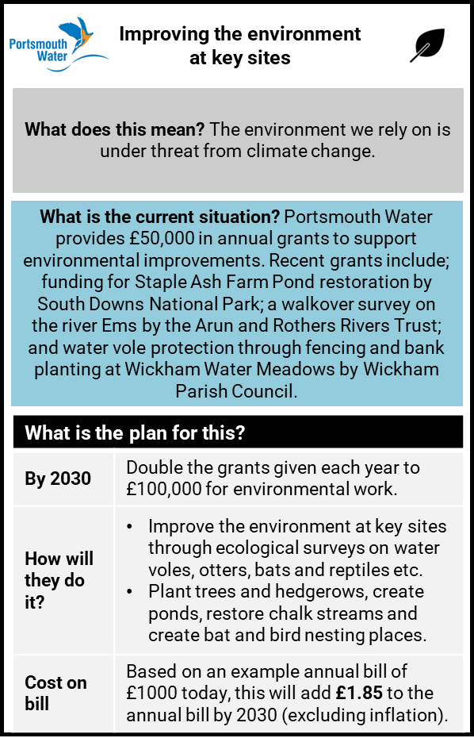
Improving the environment at key sites
STIM_6_PortsmouthWater_Households
STIM_6_PortsmouthWater_NonHouseholds

Slide 53
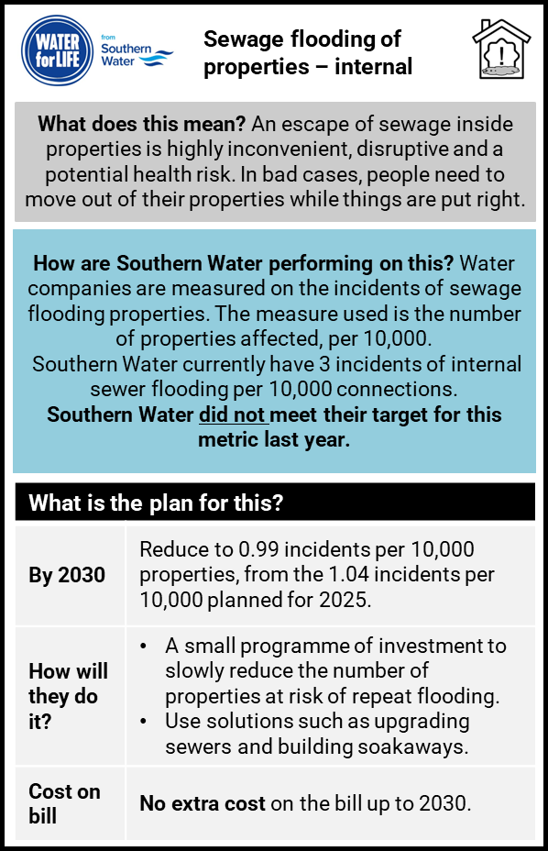
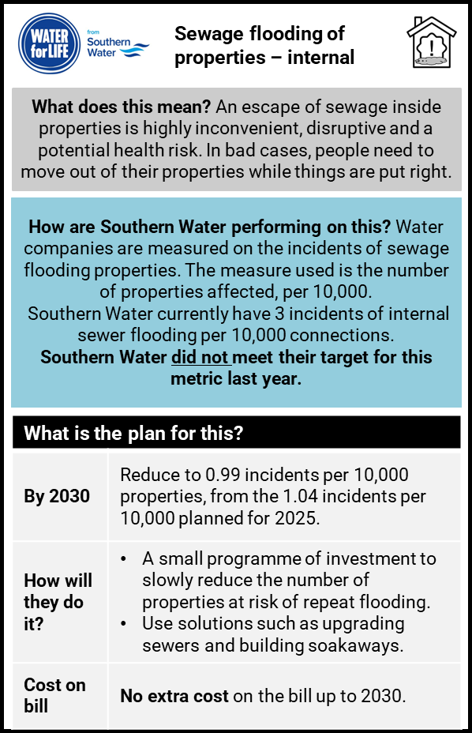
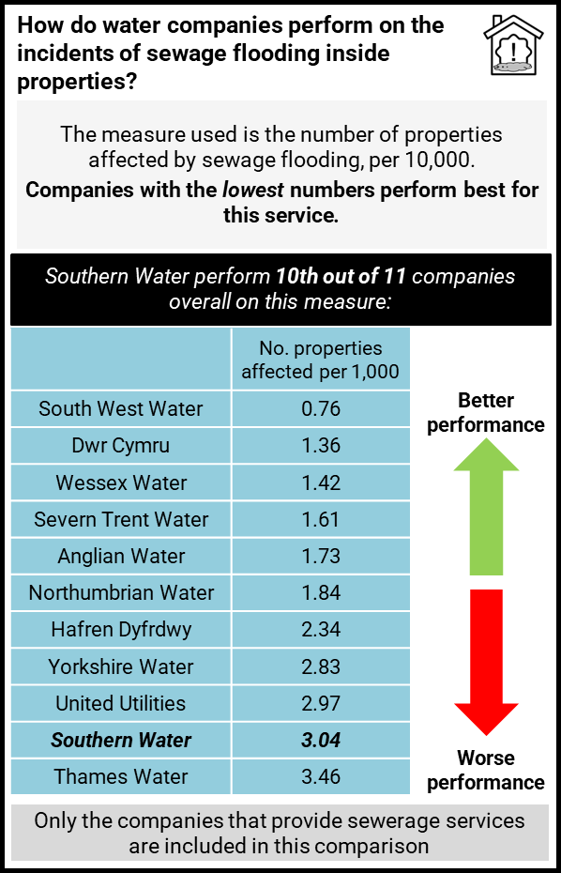
Internal sewage flooding of properties
STIM_7A_SouthernWater_Households
STIM_7A_SouthernWater_NonHouseholds
STIM_7B_SouthernWater_HH+NHH

Slide 54
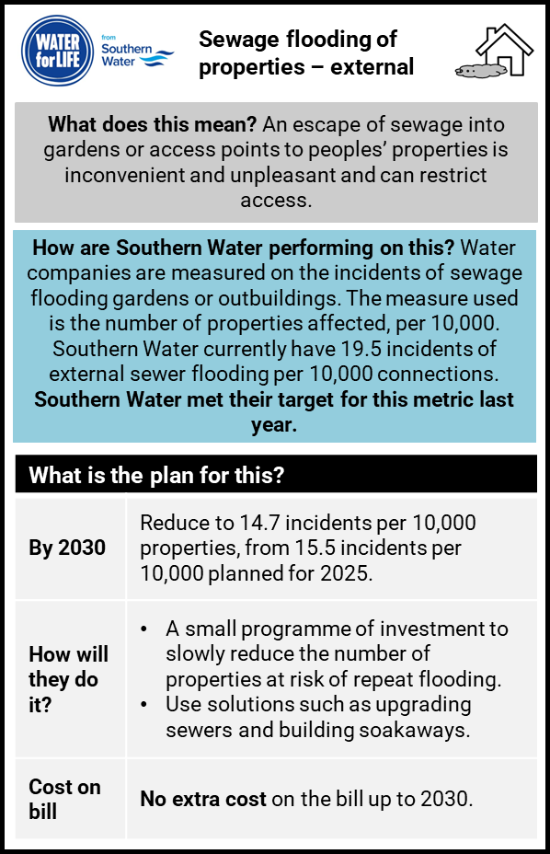

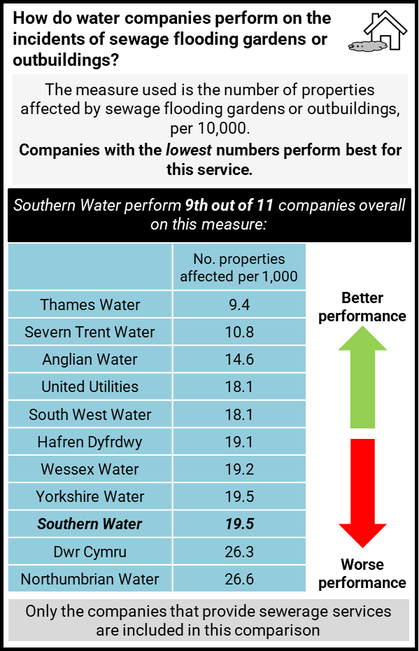
External sewage flooding of properties
STIM_8A_SouthernWater_Households
STIM_8A_SouthernWater_NonHouseholds
STIM_8B_SouthernWater_HH+NHH

Slide 55
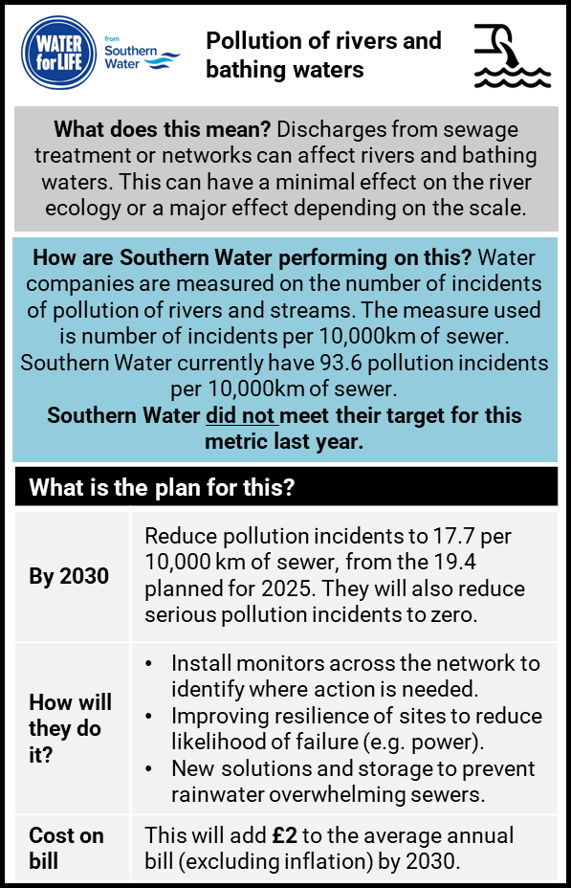
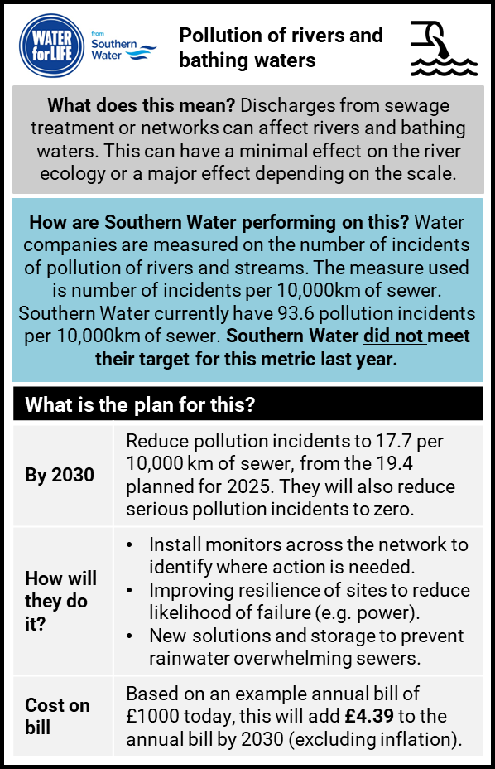
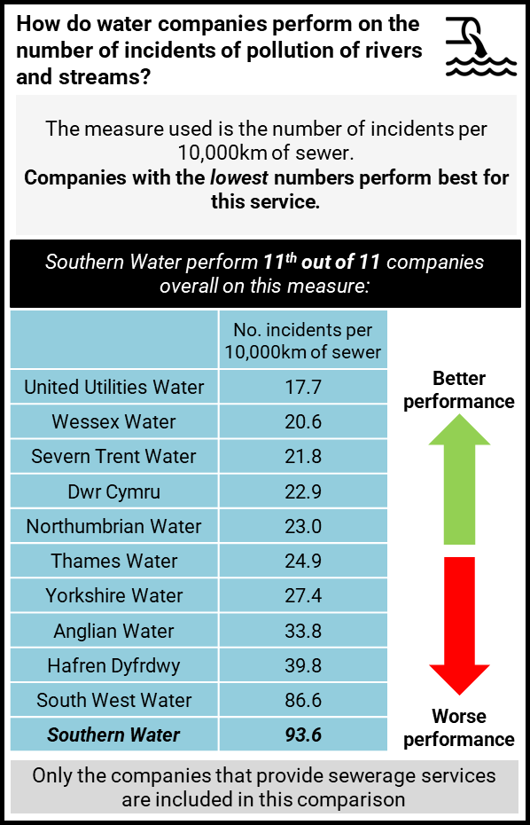
Pollution of rivers and bathing waters
STIM_9A_SouthernWater_Households
STIM_9A_SouthernWater_NonHouseholds
STIM_9B_SouthernWater_HH+NHH

Slide 56
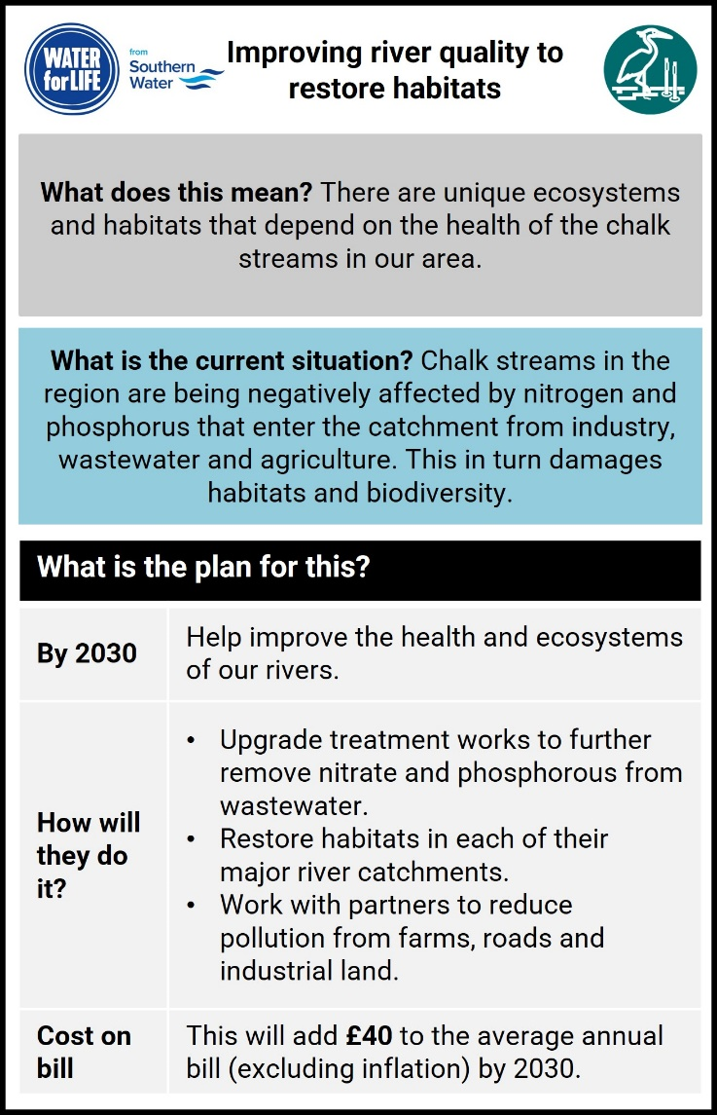
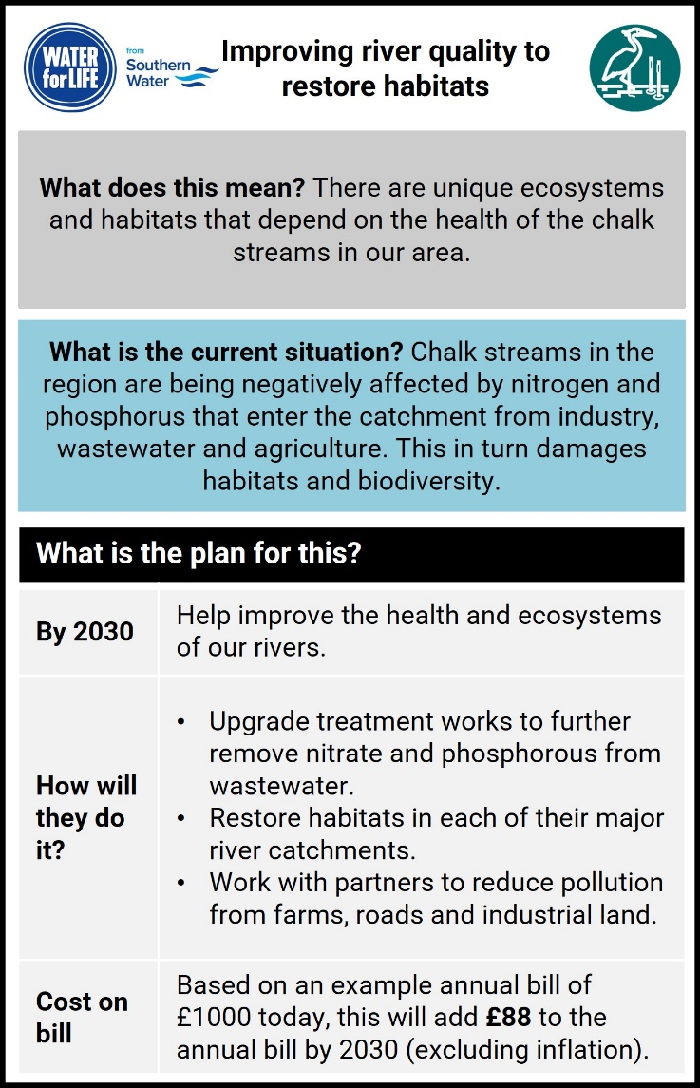
Improving river quality to restore habitats
STIM_10_SouthernWater_Households
STIM_10_SouthernWater_NonHouseholds

Slide 57
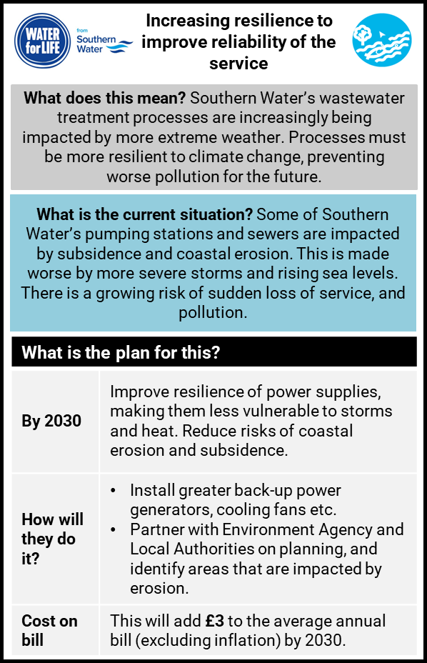
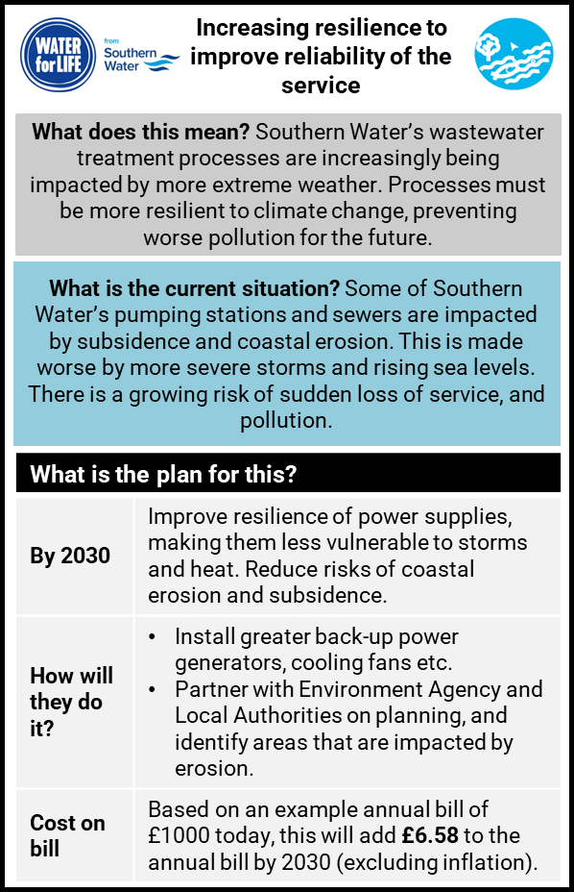
Increasing resilience to improve reliability of the service
STIM_11_SouthernWater_Households
STIM_11_SouthernWater_NonHouseholds

Slide 58
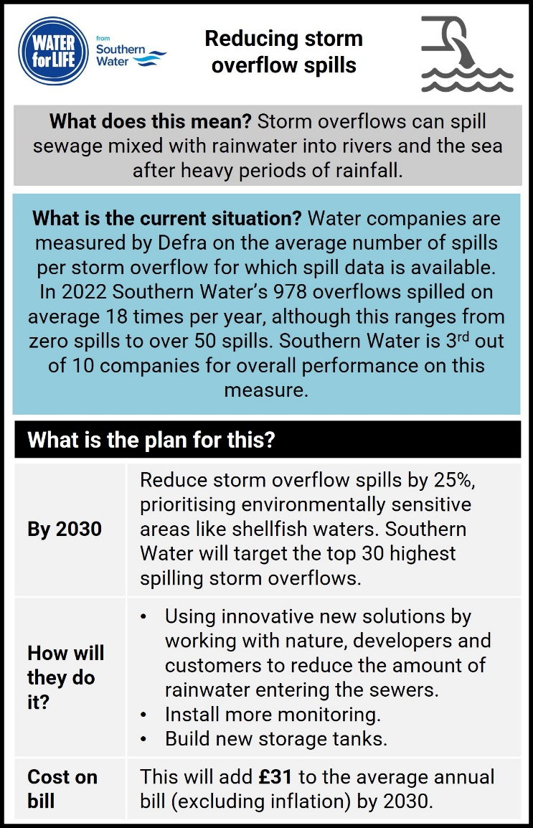
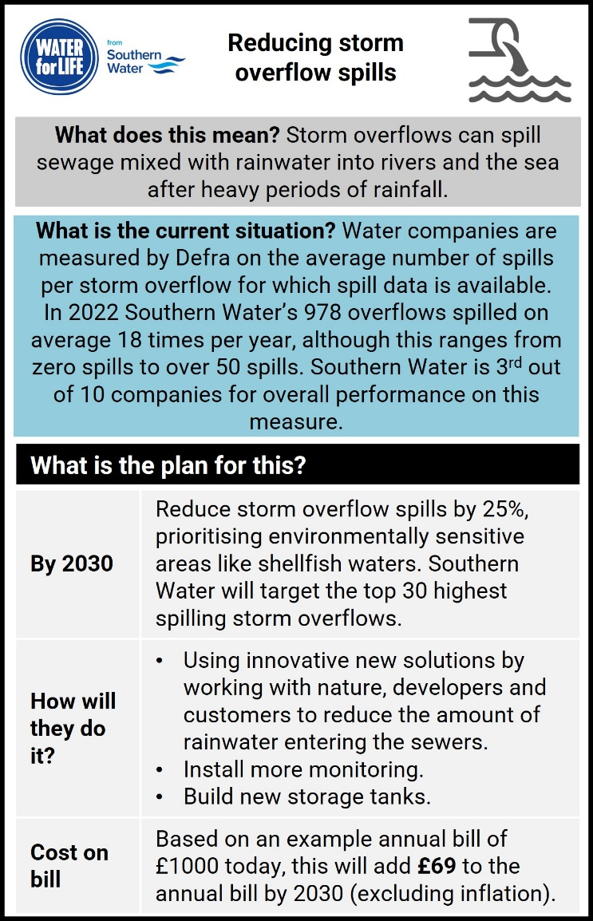
Reducing storm overflow spills
STIM_12_SouthernWater_Households
STIM_12_SouthernWater_NonHouseholds

Slide 59
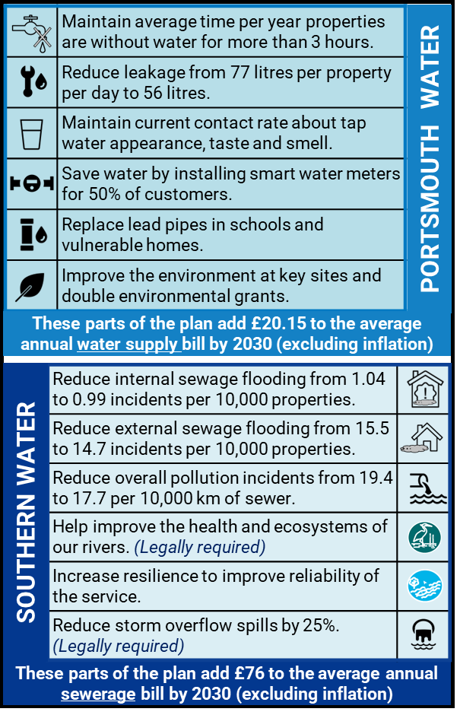
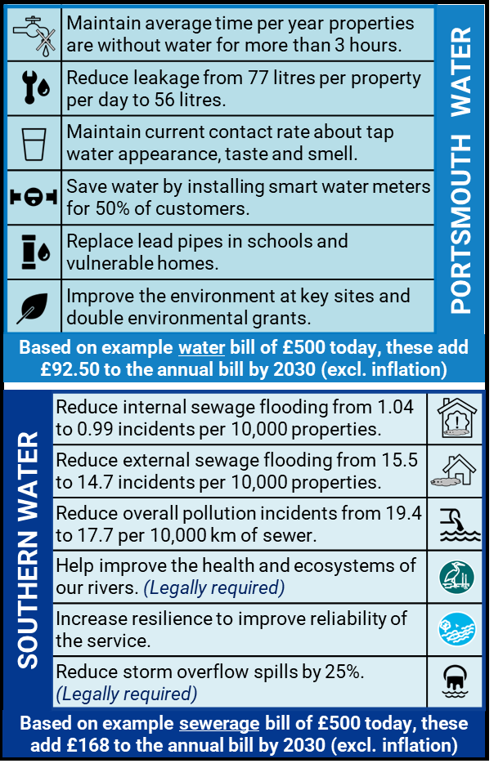
Summary of overall plans (Portsmouth Water and Southern Water)
STIM_13_PortsmouthWaterSouthernWater_Households
STIM_13_PortsmouthWaterSouthernWater_NonHouseholds

Slide 60
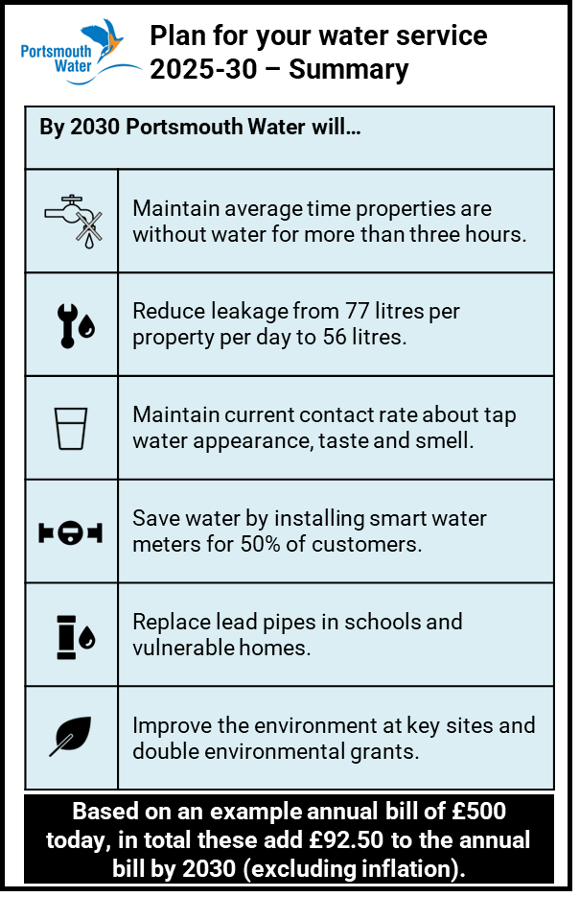
Summary of plans for water service (Portsmouth Water)
STIM_14_PortsmouthWater_Households
STIM_14_PortsmouthWater_NonHouseholds

Slide 61
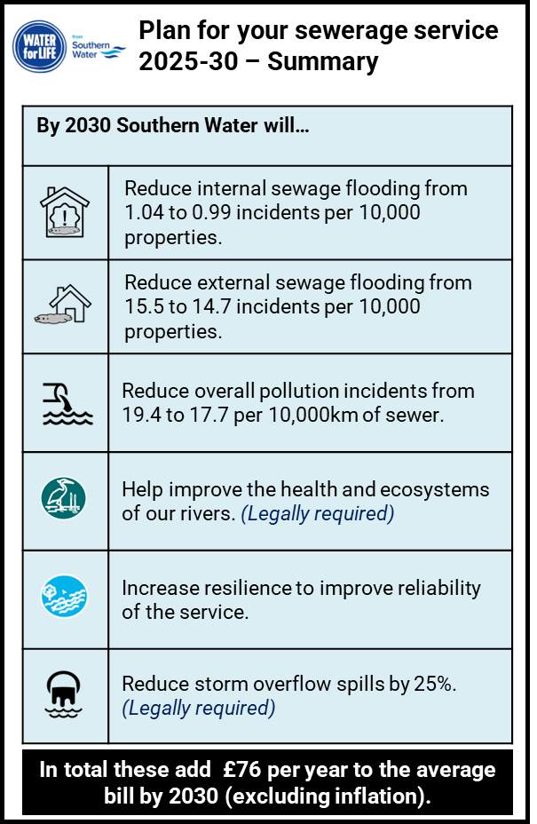
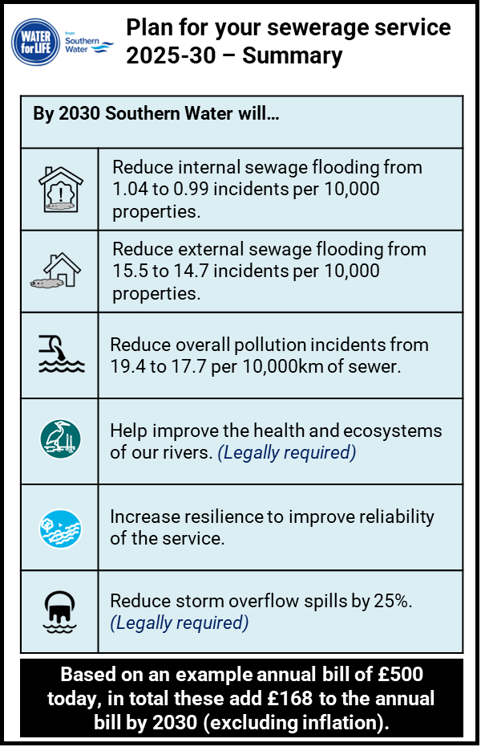
Summary of plans for sewerage service (Southern Water)
STIM_15_SouthernWater_Households
STIM_15_SouthernWater_NonHouseholds

Slide 62
Appendix 3 – Technical and assurance

Slide 63

Addressing Ofwat’s research principles
63
76. QuantAAT_PortsmouthWater_FULLreport_v1.0
Standards for high-quality research: | How addressed in this project:
Useful and contextualised | This research forms part of the PR24 research requirement, and the Ofwat guidance was followed to ensure it is useful and contextualised, and to the required quality. Household respondents were recruited via both email and letter which explained why the research was being undertaken. Invitations contained a link to the online survey and provisions were made to ensure that those who preferred to complete the survey on paper could easily apply to do so.
Fit for purpose | Ofwat guidance was followed to ensure both the research sample and methodology were fit for purpose. Blue Marble challenged some elements of the guidance directly with Ofwat where it was felt improvements could be made, and several of these were approved and implemented. The questionnaire followed the Ofwat guidance with only minimal changes reflecting that the research was being conducted for two water companies (Portsmouth Water and Southern Water) and to ensure it was clear which plan(s) were being referred to in certain questions. The survey was run and managed by QRS, an independent market research agency. Individual responses are confidential and not identifiable to Portsmouth/Southern Water. The invitations were sent to a randomly drawn selection of customers from Portsmouth Water’s overall customer database with minimal exclusions. Southern Water’s sewerage bill data was appended at the outset to enable total combined water supply and sewerage bill profiles to be shown. The response rate was high, resulting in a robust base size of 582 household customers, enabling robust analysis of the key subgroups of interest. While we recognise that the sample was self-selecting, with no quotas imposed, good subsamples of all demographic groups were achieved, and weighting was applied to the data to compensate for the demographic skew in the unweighted total (see page 4 for details).
Neutrally designed | Blue Marble followed Ofwat’s prescribed questionnaire design as per Appendix F of the Ofwat guidance. The quantitative survey used balanced answer lists, randomised answer lists and gave options to say ‘don’t know’ as prescribed by Ofwat’s guidance.
Inclusive | The report reflects a wide range of perspectives by including the views of household and non-household customers. The survey was sent to a random sample of 8,800 household customers, of which 6.6% elected to respond (without the need for a reminder to be sent). Robust subsamples of a range of customer types were achieved, including younger and older age groups, all social grades and customers with vulnerabilities. A mix of telephone invitations to NHH customers, recruitment via online NHH panels and email invitations via retailers were used to maximise response from NHH customers
Continual | While this was a one-off project, required by the regulator, it forms part of an ongoing commitment to engage with customers.
Shared in full | Portsmouth Water to publish this report and supporting appendices on its website.
Ethical | Blue Marble is a company partner of the MRS, senior team members are all Members of the MRS and/or SRA. All Blue Marble’s employees abide by the MRS Code of Conduct and as such all our research is in line with their ethical standards.
Independently assured | Sia Partners audit
https://www.ofwat.gov.uk/wp-content/uploads/2022/02/PR24-customer-engagement-policy.pdf

Slide 64

Blue Marble Research Ltd
www.bluemarbleresearch.co.uk
01761 239329

