Slide 1
Summary of PR24 customer engagement triangulation.

Slide 2
2
Ongoing triangulation has been a cornerstone of the engagement programme
Blue Marble has produced 6 synthesis reports over 2 years
Initial synthesis of research reports
Ongoing synthesis of research reports
Q4
Q1
Q2
Q3
Q4
Q1
Q2
*The 6th report combines 2 quarters and is due to be issued later in September 23.
2021 Design Evidence Register
2022 2023
A total of 76 separate reports are included in this review
24 reports relate to research commissioned by Portsmouth Water supporting its business planning process
Other reports include:
Research conducted for Southern Water (the two companies shared outputs throughout)
Research conducted for WRSE in relation to the WRMP
Reports published by industry bodies: Ofwat, CCW, DWI, Water UK, Waterwise
Other publicly available sources pertaining to consumer context and cost of living crisis
The reports are reviewed and the content is captured systematically, with all consumer data and insight relating to the ‘Big Conversations’: a code frame designed as part of the PR24 research programme and refined during the initial synthesis of research.

Slide 3
A total of 76 reports have been reviewed
3
‘21Q4
1 | Customer Engagement and Triangulation PR19 summary
2 | Customer Preferences to Inform Longterm Water Resource Planning Synthesis of Findings – Summary Report Water Resources South East (WRSE) March 2021
3 | Customer Preferences to Inform Longterm Water Resource Planning Part A Evidence Review Water Resources South East (WRSE) February 2021
4 | Customer Preferences to Inform Long-term Water Resource Planning Part B Deliberative Research Water Resources South East (WRSE) February 2021
5 | Customer Preferences to Inform Long-term Water Resource Planning Part C Customer Survey Water Resources South East (WRSE) March 2021
6 | Semiotics Brand Exploration
7 | Yonder Clockface Initial analysis August 2021
8 | Water Futures 2050 future customer insights Sept 2021
9 | Water for Life Hampshire: 3 research documents ‘Introductory email; Water options survey and Qualitative summary
10 | WaterVoice Views of current customers on water resources. Summary report
11 | Public views on the water environment
12 | Household customer complaints about water companies ccwater.org.uk
13 | Water Matters: highlights report 2020
14 | ICS Business Benchmarking Portsmouth Water July 2020
15 | 2021 Service mark – Assessor Report 2021
16 | ICS Who do you trust April 2021
17 | Water Futures 2030 - November 2021 - Metrics for priorities
18 | Water UK Omnibus Research Report Dec 2021
19 | Water Recycling engagement strategy Nov_30_2021
20 | Water Futures 2030 - Feedback on Regional Plan Feb '22
21 | Public Attitudes Towards Smart Water Meters
22 | Portsmouth Water Foundational Qualitative Research
23 | Southern Water | Water Futures 2050 Panel | Wave 6 Feedback on WRSE plans
24 | Southern Water | Water Futures Business Panel | Pilot wave Feedback on WRSE plans
25 | Portsmouth Water Stakeholder research: Business plan priorities
26 | Portsmouth Water Barometer Wave 1 Report
27 | Southern Water Expert Insight Panel Report; SUSSEX, KENT, HAMPSHIRE AND ISLE OF WIGHT
28 | Relish - reputation deep dive 07-03-22
29 | Southern Water Image & Reputation Research Report
30 | SW Water Futures Wave 5 report_231221_Final Jan '22.pdf
31 | 3522pre01_Spontaneous Priorities_Qual_v2 Dec '21.pdf
32 | Understanding customers’ preferences for Performance Commitments at PR24
33 | Supporting vulnerable customers report 2022 FINAL
34 | Cost-of-living-report-Final.pdf
35 | CCW-Water-Awareness-Report.pdf
36 | Southern Water - Long Term Strategy Session.docx
37 | Water Futures 2030 April 2022 Report.pdf
38 | Affordability Concerns and Diverse Cultures - April 2021.pdf
39 | Consumer Panel Barometer - Wave 2
40 | Customer Advisory Panel - Report 1
41 | Vulnerable Customer Research - Wave 1
42 | Southern Water: PR24 - spontaneous priorities customer and stakeholder insights
43 | CMex presentation LYM 20220519 v2.ppt (also read Cmex Summary.xlsx alongside this report)
44 | Portmouth Water Audited 2021-22.xlsx AND Portsmouth Q4 2020-21 Final.xlsx
45 | Portsmouth Water_FINAL.pdf
46 | Portsmouth Water_Vulnerablecustomerssummer2022_Presentation_FINAL
‘22Q3
47 | South East - Customer Priority Event - 5th October 2022 FINAL
48 | Southern Water - WF2030 Diverse Cultures Summary 121022
49 | Cross Cutting Customer Themes - Draft 1 Sep '22
50 | Exec Co Oct 22
51 | SW Smart Water Meter Qual Debrief_Relish_20.07.22_Final (002)
52 | WRMP24 - Customer Insight Summary 05 05 22
53 | Customer Summary - PR24 v4 Sep '22
54 | Southern Water Repositioning Deck
55 | SW NHC Panel Wave 1 Report_210722
56 | Water Futures 2050 infographic June 2022
57 | Consumer Panel Barometer - Wave 3
58 | Portsmouth Water_Crosssubsidysurvey_reportv1.0_121222
59 | FINAL-Trust-and-perceptions-views-on-the-water-sector (1).pptx
60 | PW Future Customer Panel 2022 Report FINAL Dec 2022.pptx
61 | PW PR24 CAP2 Summary Report.pptx
62 | DWI79_2_348ex_sum Public Perception of Water Recycling for Drinking Water Use.pdf
63 | Portsmouth Water_Barometer Wave 4_Report_V2.0.pptx
64 | PW Choices Survey Test CAP 3 Summary Report 270223.pptx
65 | Ofwat Collaborative ODI Research SP Results - Jan 23.pptx
66 | Cost of living: wave three. Water customer's experiences
67 | Portsmouth Water Future Customer - Plan Choices
68 | Customer Advisory Panel - report 4
69 | Plan Choices Research - Non Household Customers
70 | Portsmouth Water Plan Choices – Triangulation
71 | Affordability and Acceptability testing - QUAL
72 | Portsmouth City Council Residents Research - Wave Four – November 2022
73 | PW Smart Meter Hypercare Research FINAL REPORT 160823
74 | PW Minority Audience Interim Findings
75 | QuantAAT_PW_key measures INTERIM UNWTD_24072023_V1.0
76 | CAP 5 & Barometer 6; Small business premium & Long Term Delivery Strategy
Review of PR19
WRMP (WRSE) planning
Wider context
Long term plans and PW Vision
Affordability & vulnerability
‘22Q4
‘22Q1
Future customers
Smart meters
Affordability
Understanding customer priorities
‘23Q1
Plan choices
‘23Q2
‘22Q2
Minority audience
LTDP, Small co premium
Plan acceptability
Building evidence of priorities with a focus on WRMP
Bold type: Portsmouth Water commissioned research

Slide 4
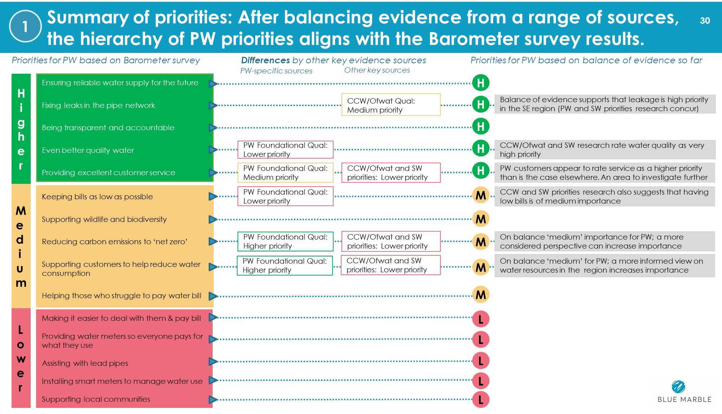
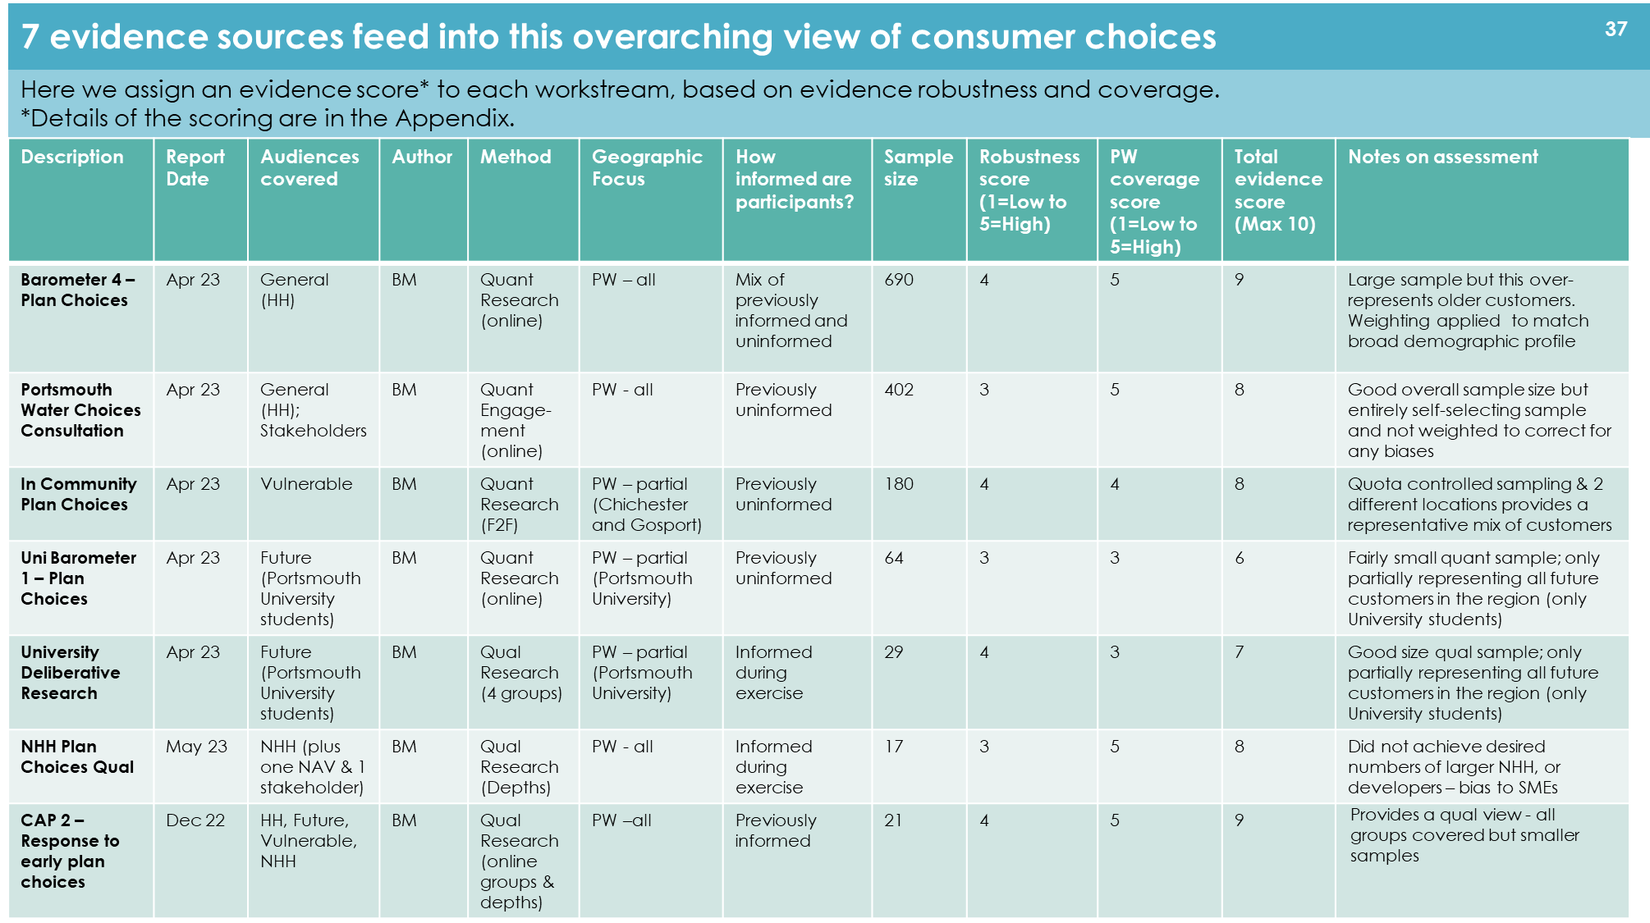
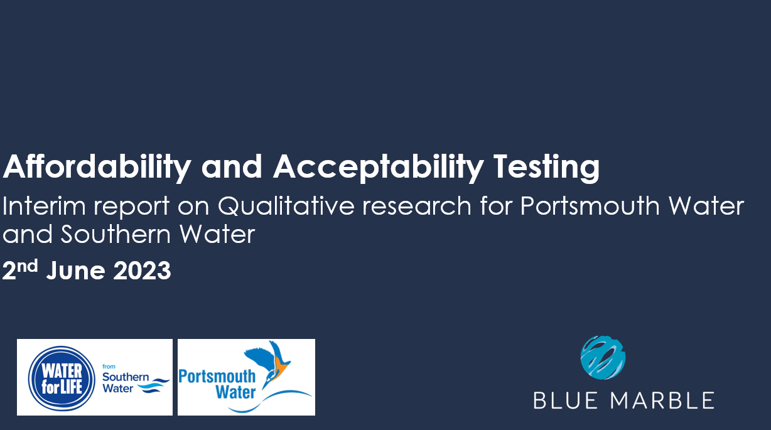
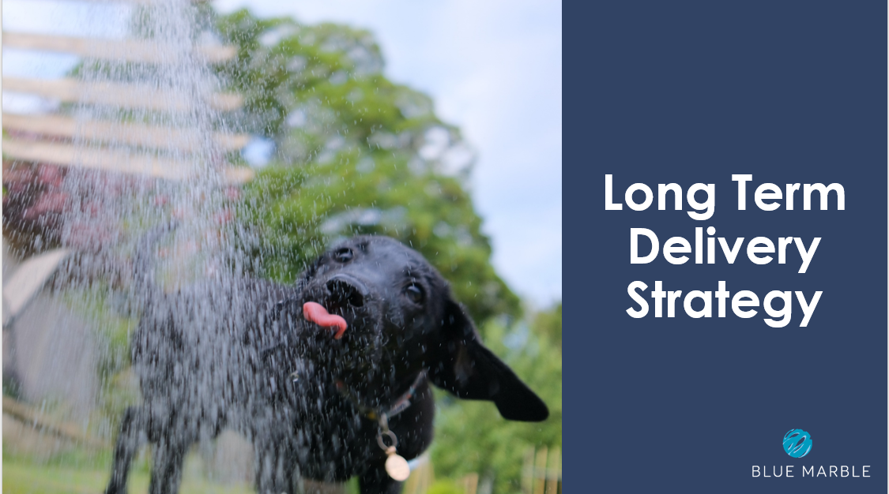
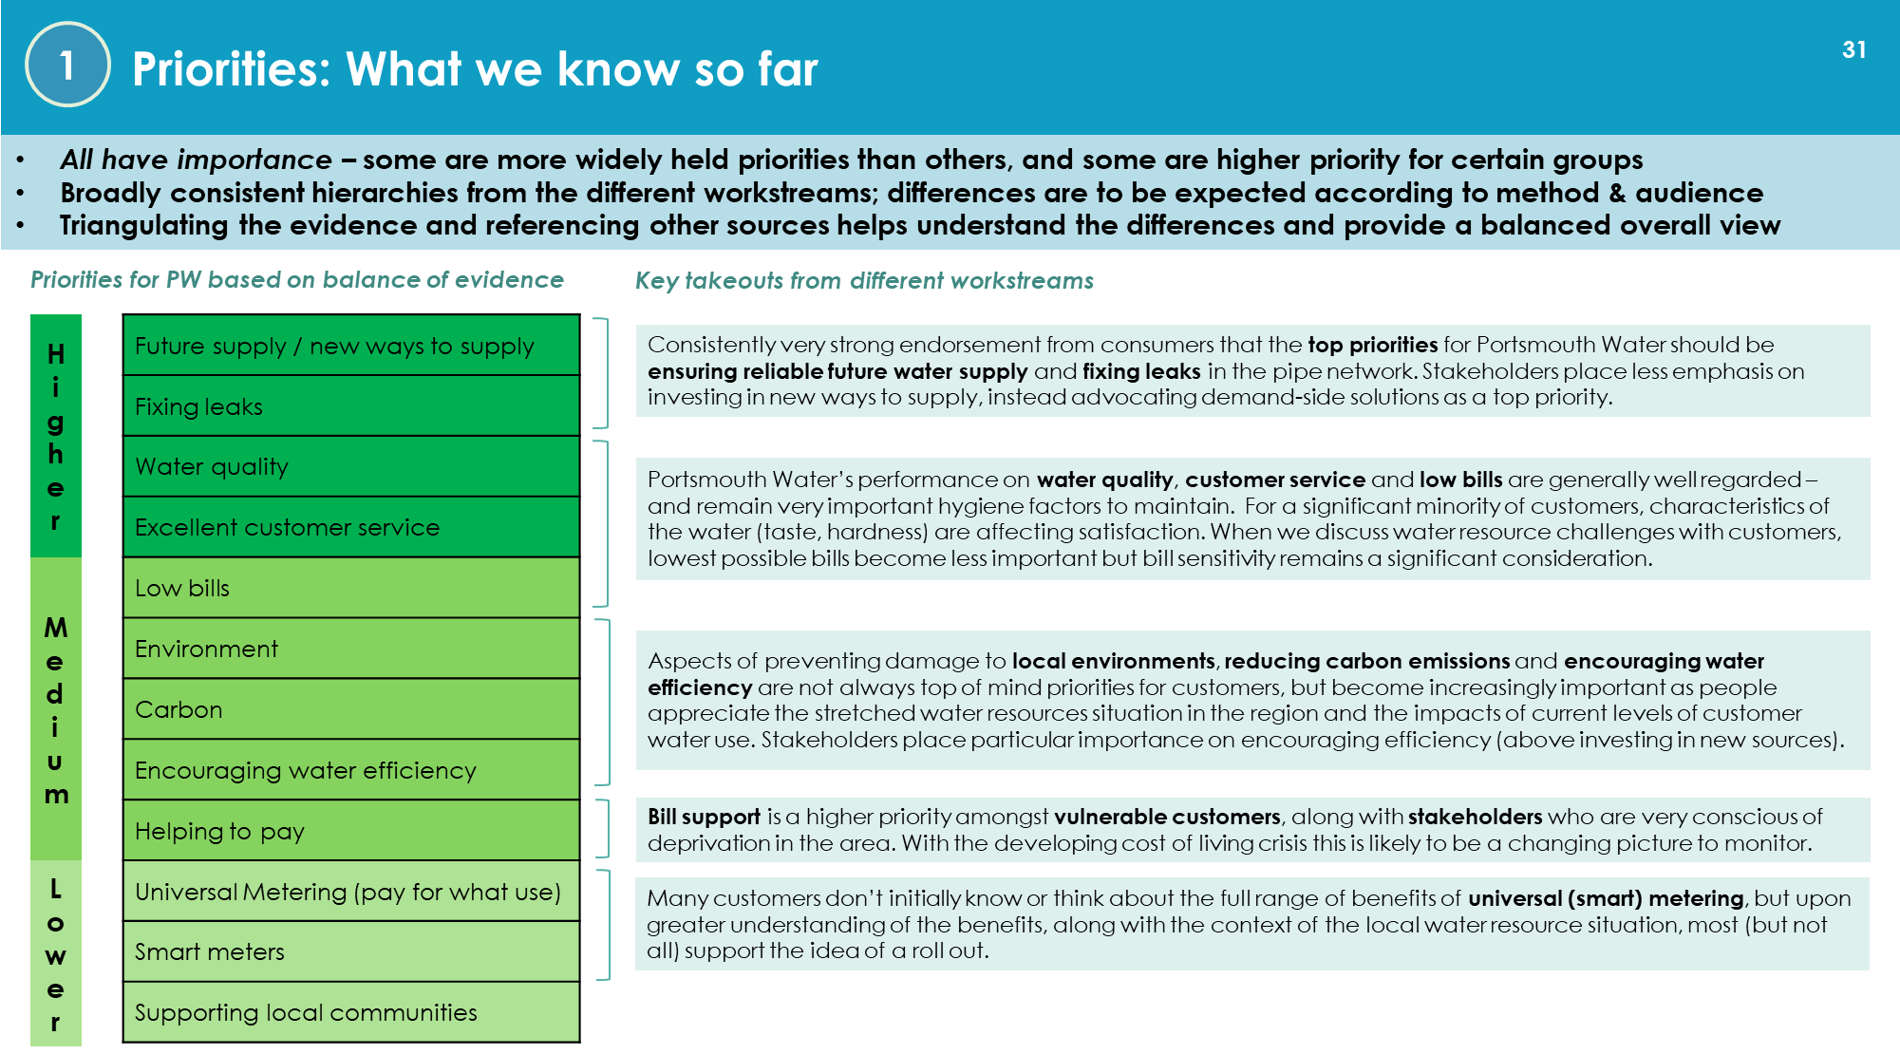
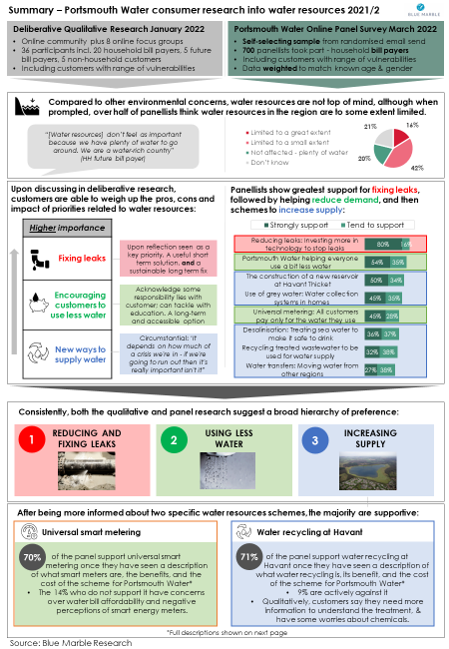
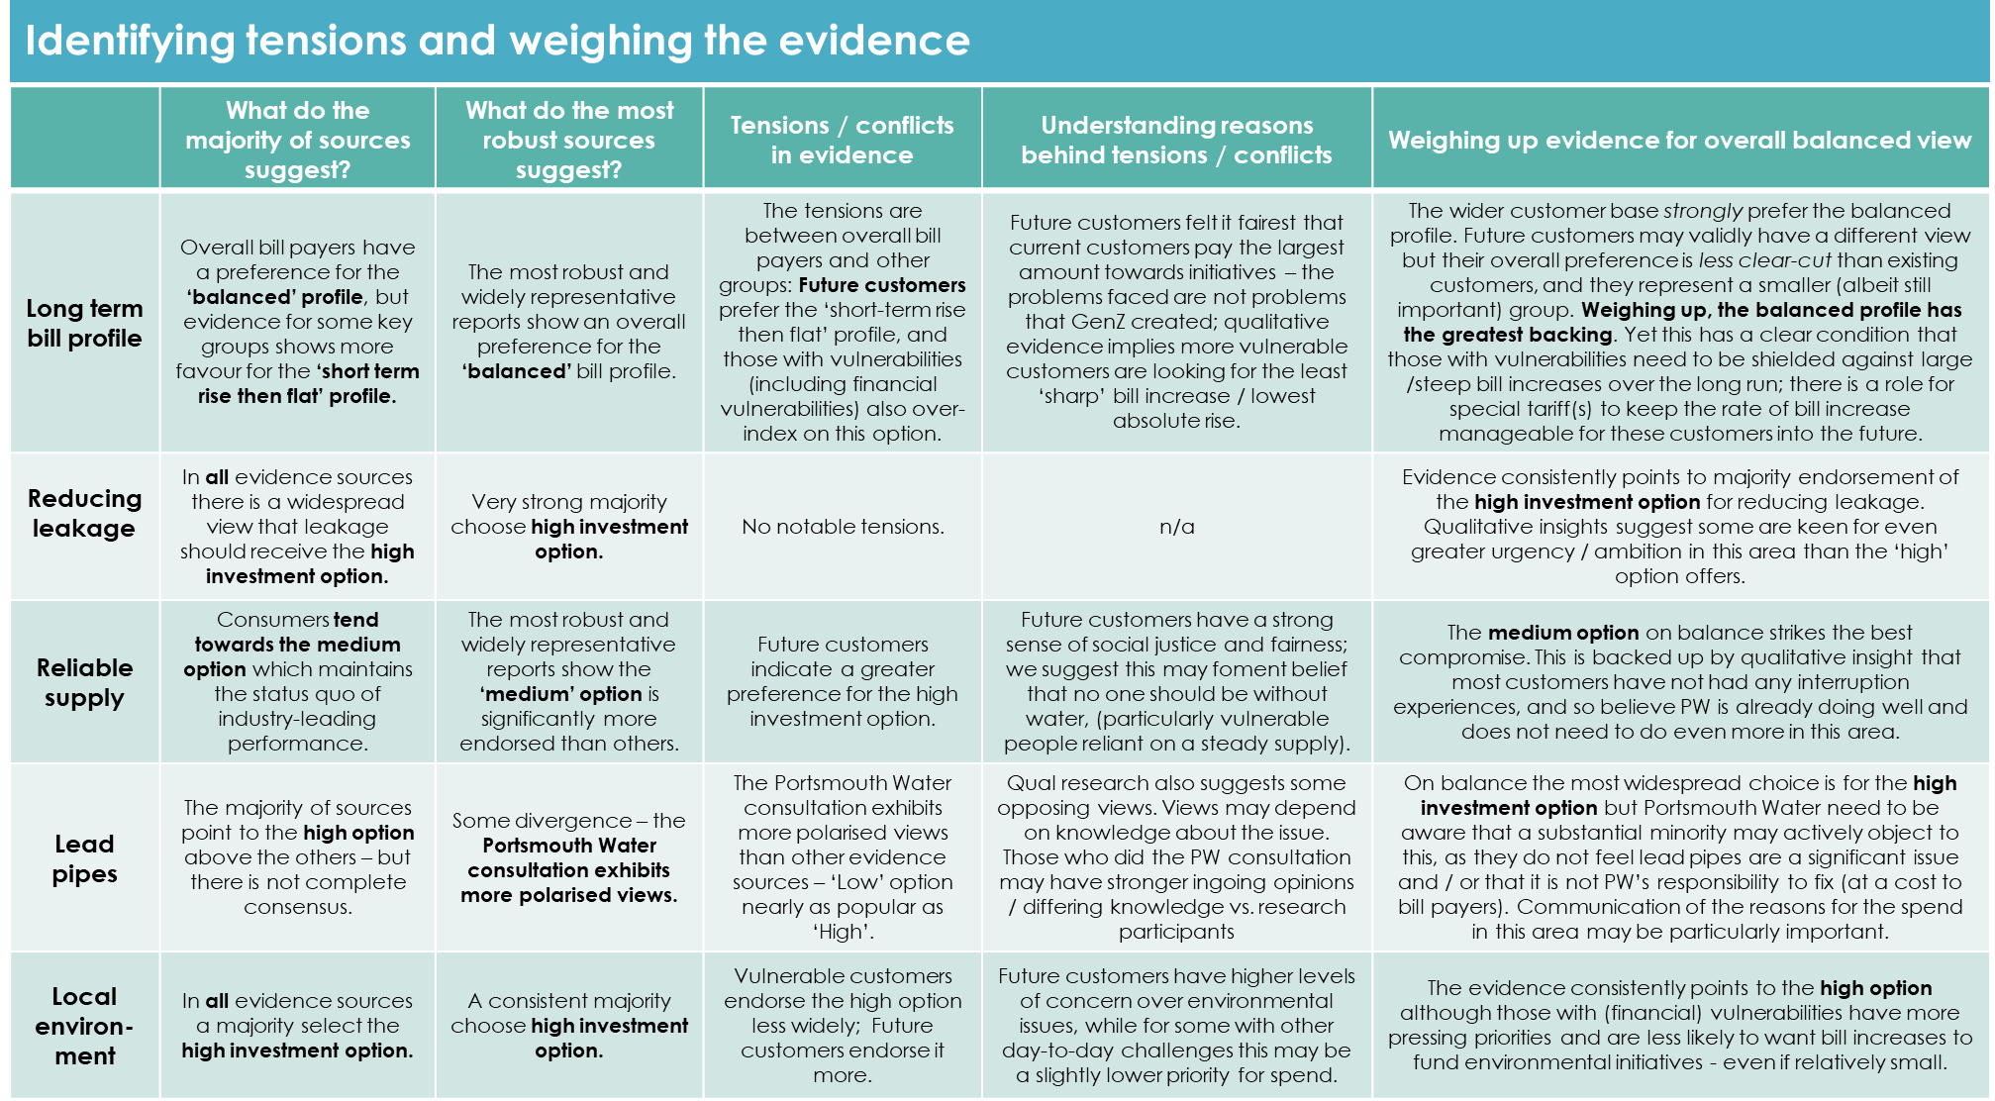
4
About this paper
This paper has been prepared to signpost how the synthesis of evidence and subsequent triangulation relates to the draft business plan. There are key clusters of evidence pertaining to the plan that are reflected in the summary:
1
2
3
Triangulation of customer priorities from across a range of sources (detailed in Synthesis Report 3 - Aug 2022)
Review of Plan Choices from 6 separate studies (detailed in Plan Choices Triangulation Report - May 2023)
Acceptability & Affordability: deliberative events and survey.
Also including recent additions to the evidence – August 2023
In weighing the evidence, we have taken account of the evidence scores (for robustness and relevance) for all the contributing reports. These are listed in the appendix.

Slide 5
5
Executive summary
Portsmouth Water have conducted a two-year programme of customer engagement using both its ongoing research vehicles together with projects commissioned specifically to inform the plan development or plug gaps when they became apparent.
This primary research has been supplemented with a systematic review of a wide variety of other relevant evidence sources.
The programme has culminated in a large sample of customers evaluating Portsmouth Water’s draft business plan though the Acceptability and Affordability prescribed methodology.
This executive summary draws on this triangulation to provide a single view of the overarching findings.
Overall affordability & acceptability
The whole body of evidence leads to the conclusion that Portsmouth Water customers endorse the draft business plan.
However, the diagram below illustrates a nuanced response to the plan elements (notably smart metering and leakage).
Around three quarters of customers rate the plan acceptable or very acceptable. (Notably this level of acceptability drops to just over half when related to the joint Portsmouth and Southern Water plan).
Customers are far less confident about their ability (or willingness) to afford the plan. Around 1 in 10 say they are already struggling to pay their water and sewerage bills. When presented with the joint bill impact (PW and SW), 46% say it will be very or fairly difficult to afford.
CUSTOMER SENTIMENT
Higher priority
Leakage is an emotive issue. The level of proposed investment, however, can disappoint relative to spend/emphasis elsewhere. | Maintain reliable supply: PW seen to be doing well - does not need to do go further in this area Water quality: high levels of acceptability to improve performance at no additional cost on the bill
Smart meters: not perceived to be meeting a customer need – nor linked with leakage reduction. Majority support plan once informed about the rationale – and on the basis of no bill impact*. * NB final plans did include £13.25 bill impact | Lead pipes: once informed, importance increases. Focusing on buildings associated with children and vulnerable reflects the key concerns customers have Environment: not an urgent investment, customers are happy with the plan
PLAN ENDORSEMENT: Weaker/ conditional
PLAN ENDORSEMENT: Stronger
CUSTOMER SENTIMENT
Lower priority
Transformational change needed in customer mindset to see role and significance of smart meters in managing demand. Customer comms will be critical.

Slide 6
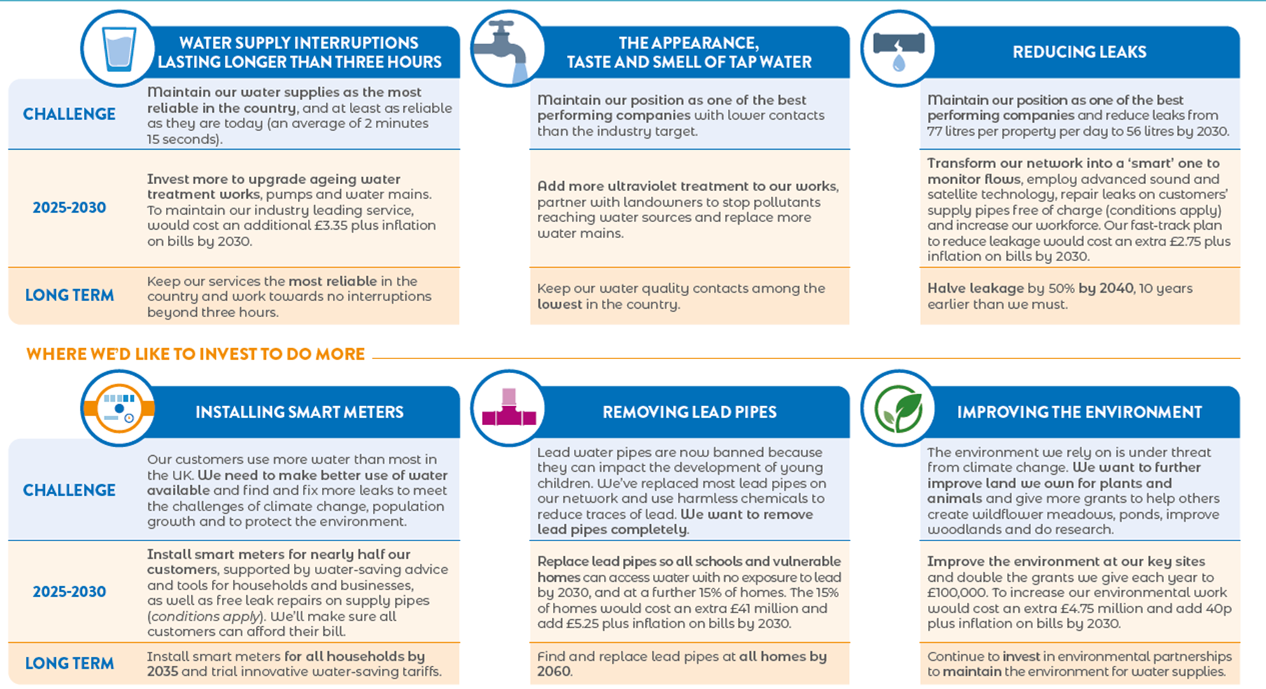
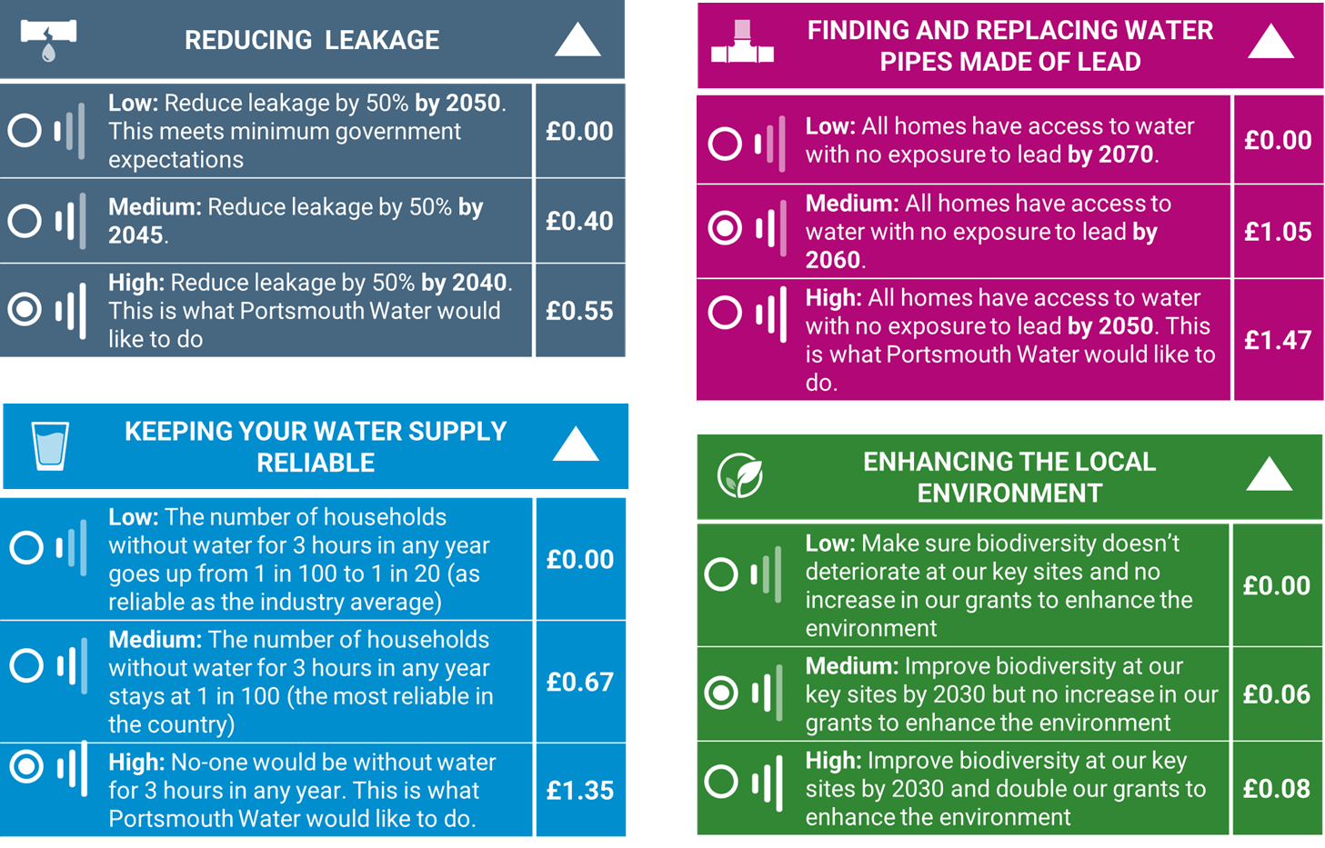
What were customers responding to?
1
Unprompted discussions
General statements about aspects of the plan
Descriptions of the long-term vision
Customer priorities
3
Customers were given information about 6 areas of the plan: 3 performance commitments and 3 areas of significant investment
Acceptability based on whole bill impact from 2025-30
Acceptability & Affordability
Customers were given descriptions of investments with three bill impact options.
Set in context of long-term vision 2025- 2050
2
Review of Plan Choices

Slide 7
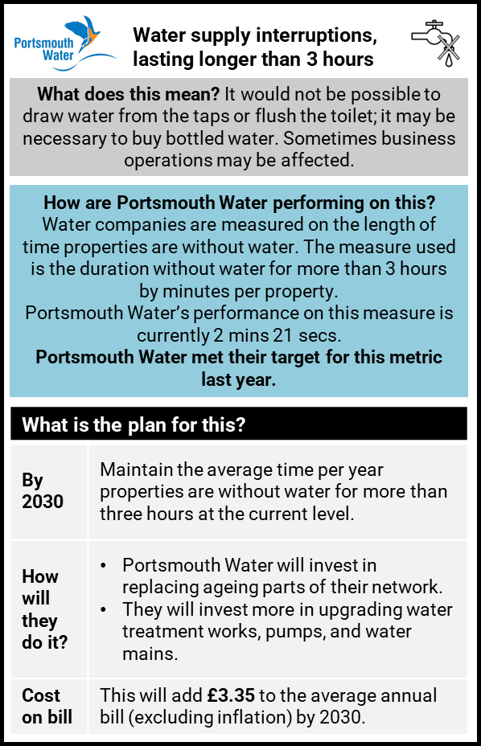
7
Weighing the evidence - Reliable supply
Is this a priority for customers? | Evidence from the long-term plan choices | Tensions / conflicts / sample differences in evidence | Understanding reasons behind tensions / conflicts
Reliability of supply/future supplies was the highest priority in the priorities triangulation exercise. Ofwat WTP shows avoiding long term interruptions to supply is more highly valued than anything else (followed by water quality). | Consumers tended towards the medium option on the choices research. Portsmouth Water do not need to go beyond their existing – industry leading – level of reliability. | Those who cannot afford the water & sewerage bill, as well as those on the borderline of affordability, are more likely than others to opt for a reduction in reliability (to the industry average), if this means no bill increase. Future customers indicate a greater preference for the high investment option. NHH felt improving supply interruption was important. | Future customers have a strong sense of social justice and fairness; we suggest this may foment belief that no one should be without water (particularly vulnerable people reliant on a steady supply). For NHH, their perspective I more about the commercial impact of being without water even for a short time.
1
2
Plan Acceptability
Water supply interruptions is less important than the other performance commitments covered in the research: Most important: Reducing leaks 52% Water quality 34% Supply interruptions 10% DK 4% Qualitatively we understands that the relative position of supply interruptions is linked to the fact that PW are already performing well against the industry and are meeting targets (and few had any sense that this was an area for improvement in need of significant investment).
3
Weighing up evidence for overall balanced view
Strong evidence that customers hold reliability of supply highly. Ensuring that customers don’t experience severe interruption to their supply is seen as important, particularly for customers with families or vulnerabilities who might rely on a steady water supply – and businesses/ organisations. The plan is maintaining an already strong position in customers’ minds. The Plan Choices work tested a more ambitious outcome but on balance this was not chosen – the extra spend not deemed to be required. Hence including a ‘maintain’ target in the plan is backed by the evidence: PW is already doing well and does not need to do even more in this area.

Slide 8
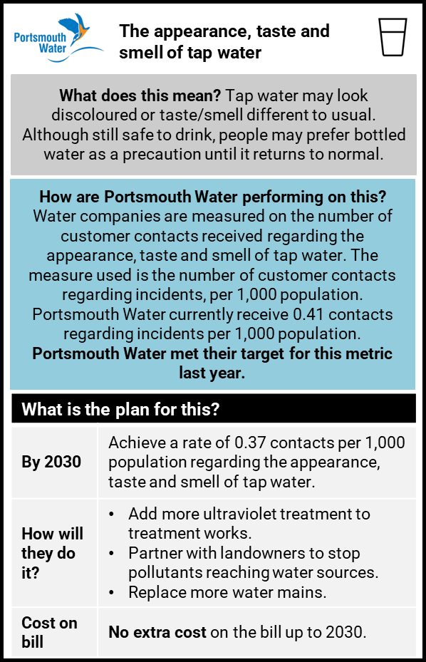
8
Weighing the evidence – Water quality
Is this a priority for customers? | Evidence from the long term plan choices | Tensions / conflicts / sample differences in evidence | Understanding reasons behind tensions / conflicts
While tap water quality was generally satisfactory in PW’s qualitative evidence, and so deemed less of a priority, it was a higher priority in the survey data: poor perceived taste, appearance or water hardness is often connected to lower satisfaction. CCW/Ofwat and Southern Water research also assign water quality a very high priority. Current performance for colour and appearance (Water matters 2021) is 95% for PW customers indicating this is not an area of concern. | No choices included for water quality. Water supply issues (taste, pressure) mentioned spontaneously by 4% in the Consultation Survey | NA | NA
1
2
Plan Acceptability
Of the three performance commitments covered in the research, water quality is most important for a third of customers – lower than the leakage but above the supply interruptions. Most important: Reducing leaks 52% Water quality 34% Supply interruptions 10% DK 4% In the deliberative (qualitative) research, customers rated water quality as an important area for investment but had no concerns about existing quality. They supported the plan target and no bill impact.
3
Weighing up evidence for overall balanced view
Evidence supports the proposed target in the business plan. Customers expect high quality water and happy to see PW performing highly compared to the industry The plan is uncontentious: high levels of acceptability to improve performance at no additional cost on the bill.

Slide 9
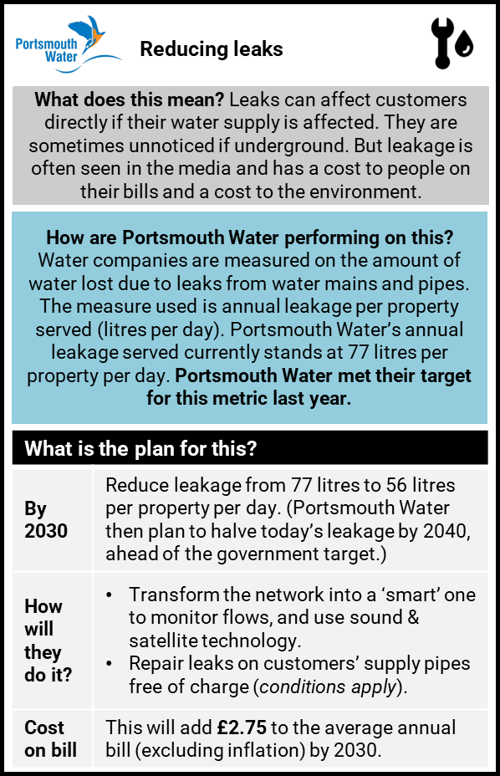
9
Weighing the evidence – Reducing leaks
Is this a priority for customers? | Evidence from the long term plan choices | Tensions / conflicts / sample differences in evidence | Understanding reasons behind tensions / conflicts
Throughout the body of evidence there is very strong endorsement from consumers that fixing leaks in the pipe network is a top priority for Portsmouth Water. | Evidence consistently points to majority endorsement of the high investment option for reducing leakage ahead of the industry commitment. Qualitative insight suggest some are keen for even greater urgency / ambition in this area than the ‘high’ option offers. | Universally important – and urgent. Some think water companies should ‘get their houses in order’ before asking customers to reduce their usage. | Customers support leakage reduction for many reasons: NHH see it as an effective way to increase supplies HH felt that leak reduction was the best was to manage demand over the long term. Future customers believe leakage will only worsen over time, becoming more costly, so it makes sense to address the issue as soon as possible
1
2
Plan Acceptability
Reducing leaks is seen as the most important of the 3 performance commitments: Most important: Reducing leaks 52% Water quality 34% Supply interruptions 10% DK 4% In the deliberative (qualitative) research, high levels of acceptance for the proposed plan – and it seems affordable – however some are disappointed with the rate of progress planned and were interested to see accelerated investment to halve leakage 5 years earlier (by 2035).
3
Weighing up evidence for overall balanced view
There is strong evidence for supporting ambitious leakage targets. In customers’ eyes, potential to improve on the draft targets proposed. This is the most emotive area of the plan – and a tangible way in which customers can judge Portsmouth Water. Leakage seen as a fundamental issue that undermines the credibility of water efficiency campaigns and supply schemes. Customers introduced to the LTDS note that leakage targets over the long term look unambitious with only 1% reduction from 2020 levels achieved between 2040 and 2045.

Slide 10
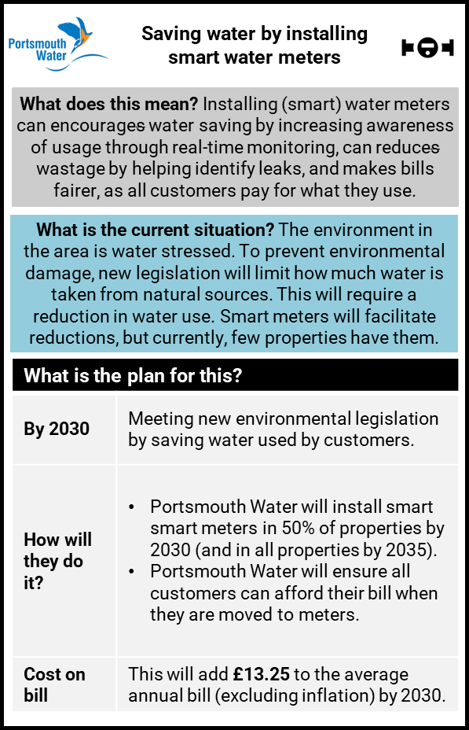
10
Weighing the evidence – Smart meters
Is this a priority for customers? | Evidence from the long-term plan choices | Sample differences in evidence across the engagement programme
Smart metering is a low priority for customers. While support for smart meters is initially muted, 7 in 10 support once benefits communicated (14% still reject smart meters) This resistant minority are concerned about bills rising, unclear how they can save money, unhappy to lose ‘guilt free’ water use, and some have data/security fears. | Not included in plan choices | Unmetered: concerned about paying more Low income and (some) younger: see smart meters as an additional stress of ‘another bill in their living room’ Digitally excluded: data security concerns / fraud risks Better off customers want to save water; worse off want to save money Oldest most interested in detecting leaks Stakeholders: negative experiences of energy smart meters: bill anxiety; obsessive monitoring; fear being cut off House shares: concerned about potential for conflict where have no control on how water efficient others are NHH most positive Future customers generally support as make wastage tangible. But they assert benefits need to be communicated, and vulnerable & digitally excluded must not be left behind. Generally: Access to personalised smart meter data only really appealed for a minority
1
2
Plan Acceptability
Saving water by installing smart meters is the least important of the three business plan investments tested: Most important: Removing lead pipes 39% Improving the environment 33% Saving water by installing smart meters 19% DK 9% NB: In the deliberative (qualitative) research, the plan for smart meter introduction bore no bill impact. Customers held mixed views with some resistant but were accepting on the basis of no bill impact. (The plan was revised ahead of the quantitative survey.)
3
Weighing up evidence for overall balanced view
Broadly there is support for smart meters when understood as enabling financial saving, informed choices & helping educate. However, there is a significant minority – often lower income and vulnerable households – that object. Additionally, there is lower willingness generally to pay for smart meter rollout while the benefits are not fully understood. Evidence from the LTDS work highlights that customers often do not link smart meters and leak reduction but see as separate initiatives: they are not clear why smart meters appear to be the main focus of the delivery plan where leakage targets look unambitious. While a minority actively welcome smart meters, there are many barriers that Portsmouth Water will need to help customers overcome through its delivery and communications. These barriers to water smart meters can vary by customer segment and call for targeted communications where possible.

Slide 11
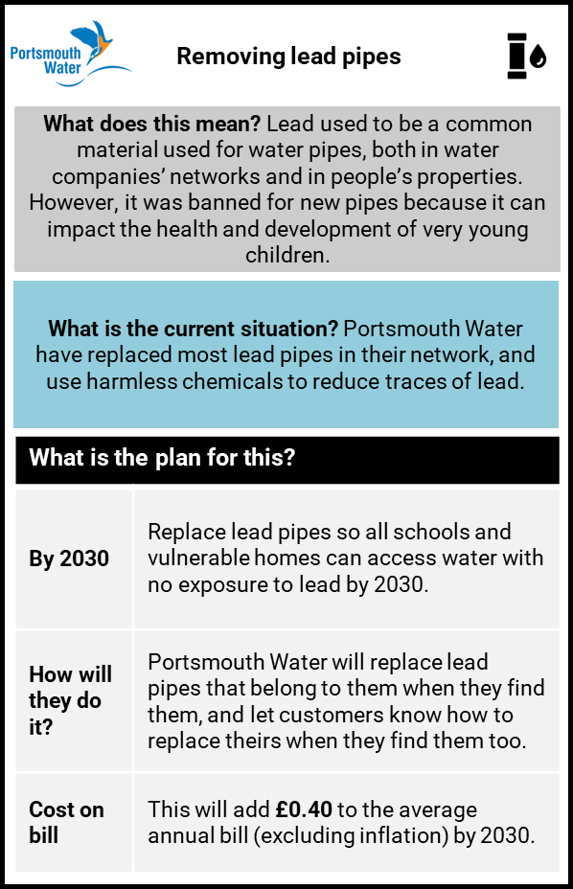
11
Weighing the evidence – Lead pipes
Is this a priority for customers? | Evidence from the long term plan choices | Tensions / conflicts / sample differences in evidence | Understanding reasons behind tensions / conflicts
Lead pipe replacement was a lower priority when set against all areas of PW’s operation (where reliable water supplies, leak reduction etc. are of higher importance). However, once informed about the lead issue, the issue evokes a more emotional response and is seen as a higher priority. Lead is the most important of the three discretionary areas in the business plan. | When shown long term investment choices for lead replacement, on balance the widespread preference was for the high investment option (no exposure to lead by 2050). NB a substantial minority opt for no additional investment reflecting the view that lead pipes are not a significant issue and / or that it is not PW’s responsibility to fix (at a cost to bill payers). | Older generations more likely than younger households to be sceptical about the need to replace lead pipes. Specifically, indications that vulnerable customers more worried than others about lead pipes and want to see more ambitious plans for lead. | Two key factors affecting response: Whether customers are informed or not. In qualitative work where the impact of lead could be discussed, the issue becomes very emotive, and customers want to see lead eradicated. Proximity to children…younger households and older people with grandchildren in schools more positive about lead replacement.
1
2
Plan Acceptability
Lead pipe replacement is deemed to be more important than environmental improvements or installing smart meters: Most important: Removing lead pipes 39% Improving the environment 33% Saving water by installing smart meters 19% DK 9% In the deliberative research, the majority of customers were happy with the proposed plan on the basis that the current situation is safe (once informed about phosphate dosing). Some want to eliminate lead more quickly with a one-off bill rise.
3
Weighing up evidence for overall balanced view
Where people are informed about the impact of lead pipes, replacement is an emotive issue, and most see as very important due to its potential health implications, especially for children. The plan to focus efforts on buildings associated with children and vulnerable customers reflects the key concerns customers have Communication of the reasons for the spend in this area may be particularly important. Customers are largely unaware of the issue – and the relevance of investment is only clear once informed Potential for push back where people feel pipe replacement is the responsibility of the householder, not the water company.

Slide 12
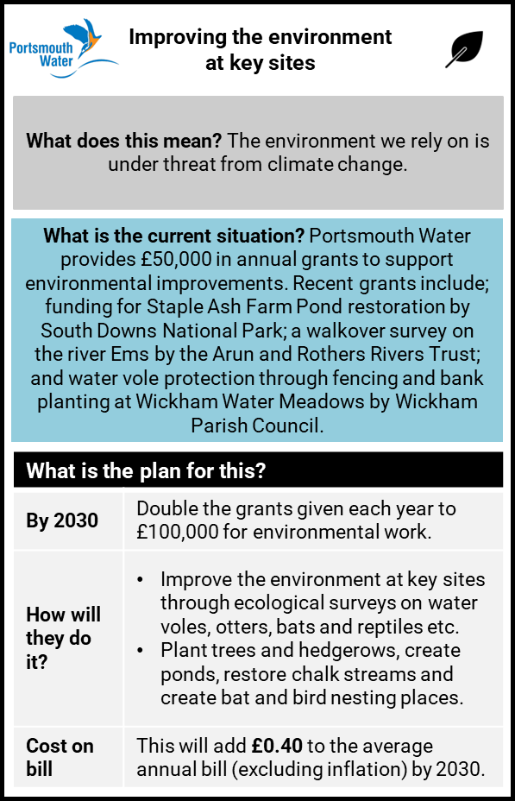
12
Weighing the evidence – Improving the environment
Is this a priority for customers? | Evidence from the long term plan choices | Tensions / conflicts / sample differences in evidence | Understanding reasons behind tensions / conflicts
For PW customers, while environment is topical, it is only a medium-level priority for PW (a water-only supplier). This is backed up by Ofwat WTP research. On learning more about local water resources and chalk streams, customers do rate preserving local environment as important for PW. | The majority choose the high investment option (albeit a relatively low cost on the bill). Future customers are particularly likely to choose the high option here, having high levels of concern over environmental issues. Customers see as an important to enhance and protect the environment, in an effort to counter the negative impact that we have on the environment more broadly. | Future (students) demonstrate higher than average understanding of environmental issues and concerns over what the future might hold. Future customers care about environmental impact but not at any cost. | Frustration from future customers over lack of urgency from government and industry in addressing the issues. But there are cost sensitivities too with this audience: they do not want cost of delivering better outcomes to fall on their generation.
1
2
Plan Acceptability
Improving the environment was rated most important by a third of the survey sample. Most important: Removing lead pipes 39% Improving the environment 33% Saving water by installing smart meters 19% DK 9% Qualitatively supportive of environmental targets. Bill impact seen to be very small - even so some question whether customers should fund or whether it should be CSR /grants
3
Weighing up evidence for overall balanced view
Evidence supports environmental improvements Support for plan detail, to double grants and improve key sites While not seen as urgent investment, customers are willing and able to pay

Slide 13
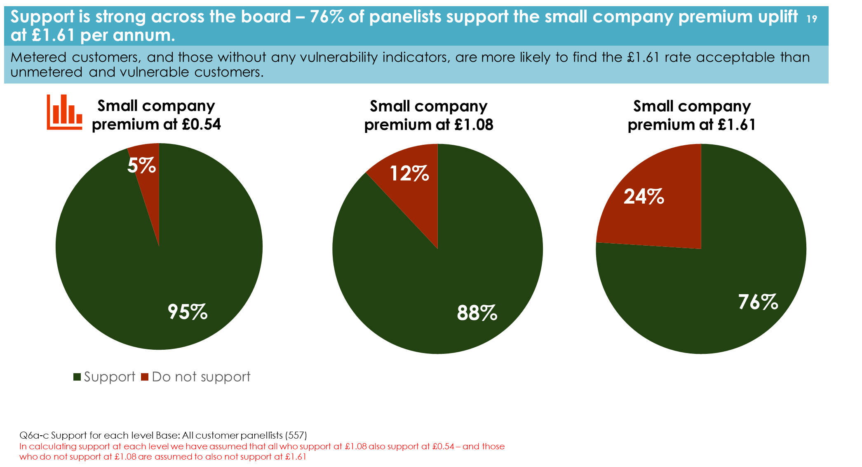
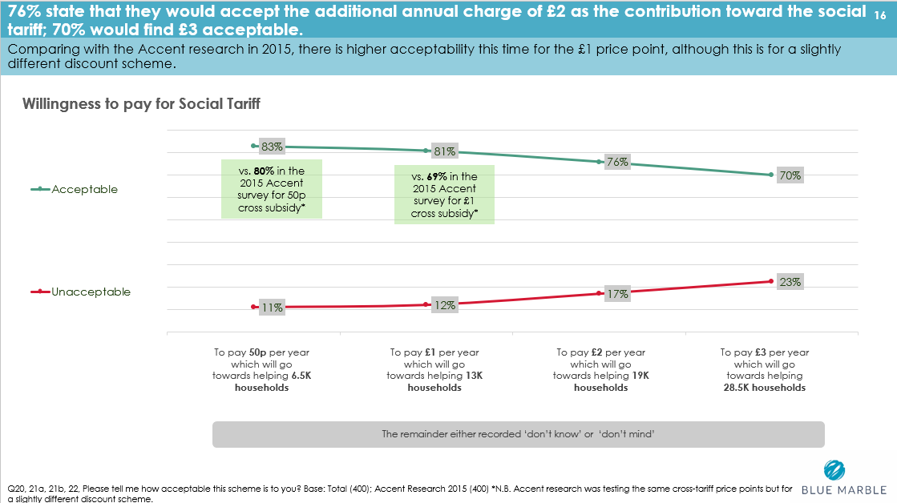
13
Supporting data for customers’ willingness to pay for specific plan aspects
Small company premium
There is widespread support for 2025-30 bills to carry a small company premium.
76% accept £1.61 with 88% accepting £1.08p.
Customers see this as a small price to pay for a company offering good service – and in the context of the planned improvements costed in the PR24 business plan.
Social tariff cross subsidy
Only 14% aware of any financial aid schemes from PW: a low level but up significantly from 2015.
Great majority (88%) support principle of social tariff although a substantial minority don't think this should be solely funded by other customers - indicating PW should pay some or all from their profits.
70% find £3 on the bill acceptable
Evidence supporting preference for a smaller subsidy that reaches a wider range of customers - perhaps indicative of broader anxiety and awareness of cost-of-living increases.

Slide 14
14
FINAL data from acceptability and affordability testing.
Affordability context
Thhe cost-of-living crisis is affecting around 2 in 5 of the population with around 1 in 10 struggling to afford water and sewerage bills. This context is apparent in the affordability scores below.
c.55% are managing financially right now with just over a quarter ‘just about managing’ and c12% finding managing finances very/fairly difficult
2 in 5 think their own financial situation is going to get worse over the next few years
Around 1 in 10 (12%) finding current water and sewerage bill hard to afford
Customers’ overall assessment of PW-only plan shows three quarters find it acceptable but just a quarter say it is very or easily affordable. Acceptability of the combined plan (with Southern) is lower at 57%, and also perceived to be much less affordable.
Plan affordability
FINAL AAT DATA – affordability of 2025-30 bill profiles based on customers’ actual bills
Water only plan
Combined water and sewerage plan
Very/fairly easy
28%
Very/fairly difficult
29%
Very/fairly easy
19%
Very/fairly difficult
44%
Plan acceptability
FINAL AAT DATA – acceptability of business plans
Completely acceptable /acceptable
76%
Completely unacceptable /acceptable
16%
Completely acceptable /acceptable
61%
Completely unacceptable /acceptable
26%

Slide 15
Appendix: data sources

Slide 16
16
Key evidence sources: priorities
1
Ref | Description | Report Date | Audiences covered | Author | Method | Geographic Focus | How informed are participants? | Sample size | Robustness score (1=Low to 5=High) | PW coverage score (1=Low to 5=High) | Total evidence score (Max 10) | Notes on assessment
26 | Barometer 1 – Uninformed priorities | Apr 22 | General (HH) | BM | QT (online) | PW – all | Uninformed | 700 | 4 | 5 | 9 | Large sample but this over-represents older customers. Weighting applied to match broad demographic profile
22 | Portsmouth Water Foundational Qualitative Research | Feb 22 | General (HH) | BM | QL (deliberative groups) | PW – all | Uninformed | 36 | 4 | 5 | 9 | Overall robust & well structured sample for qual research. NB future & NHH customers relatively small samples
25 | Portsmouth Water Stakeholder research: Business plan priorities | Feb 22 | Stake-holders | BM | QL (online depths) | PW – all | Informed | 7 | 3 | 4 | 7 | Small sample, reflecting challenges engaging with s/h throughout the programme
39 | Consumer Panel Barometer - Wave 2 | Jul 22 | General (HH) | BM | QT (online) | PW – all | Mix informed and uninformed | 574 | 4 | 5 | 9 | Large sample but this over-represents older customers. Weighting applied to match broad demographic profile
40 | Customer Advisory Panel - Report 1 | Jun 22 | General (HH) | BM | QL (4 groups) | PW – all | Unformed | 25 | 4 | 4 | 8 | Small sample of respondents covering all customer groups (HH, Fut, NHH).
46 | Portsmouth Water Vulnerable customers | Aug 22 | Vulnerable customers | BM | QL (online & f2f depths) | PW – all | Uninformed | 18 | 4 | 5 | 9 | Sample proportionate for a minority group, included digitally excluded customers
50 | Results from Vision Consultation | Oct 22 | General (HH) | BM | QT (online) | PW – all | Uninformed | 87 | 2 | 4 | 6 | Self-selecting sample
60 | PW Future Customer Panel 2022 Report FINAL | Dec 22 | Future customers | BM | QL & Qt (2 day event + online) | PW – all | Uninformed | 20 + 247 | 4 | 5 | 9
65 | Ofwat Collaborative ODI Research SP Results | Jan 23 | General (HH) | Accent | ? | National | Uninformed | ? | 4 | 5 | 9 | Made assumption that robustness reasonable but not high - details of achieved sample sizes not provided
57 | Barometer 3 – affordability & smart meters | Oct 22 | General (HH) | BM | QT (online) | PW – all | Mix informed and uninformed | 601 | 4 | 5 | 9 | Large sample but this over-represents older customers. Weighting applied to match broad demographic profile
63 | Barometer 4 – WRMP | Feb 23 | General (HH) | BM | Quant Research (online) | PW – all | Mix informed and uninformed | 434 | 4 | 5 | 9 | Large sample but this over-represents older customers. Weighting applied to match broad demographic profile

Slide 17
17
Key evidence sources: plan choices
2
Description | Report Date | Audiences covered | Author | Method | Geographic Focus | How informed are participants? | Sample size | Robustness score (1=Low to 5=High) | PW coverage score (1=Low to 5=High) | Total evidence score (Max 10) | Notes on assessment
Barometer 5 – Plan Choices | Apr 23 | General (HH) | BM | Quant Research (online) | PW – all | Mix of previously informed and uninformed | 690 | 4 | 5 | 9 | Large sample but this over-represents older customers. Weighting applied to match broad demographic profile
Portsmouth Water Choices Consultation | Apr 23 | General (HH); Stakeholders | BM | Quant Engage-ment (online) | PW - all | Previously uninformed | 402 | 3 | 5 | 8 | Good overall sample size but entirely self-selecting sample and not weighted to correct for any biases
In Community Plan Choices | Apr 23 | Vulnerable | BM | Quant Research (F2F) | PW – partial (Chichester and Gosport) | Previously uninformed | 180 | 4 | 4 | 8 | Quota controlled sampling & 2 different locations provides a representative mix of customers
Uni Barometer 1 – Plan Choices | Apr 23 | Future (Portsmouth University students) | BM | Quant Research (online) | PW – partial (Portsmouth University) | Previously uninformed | 64 | 3 | 3 | 6 | Fairly small quant sample; only partially representing all future customers in the region (only University students)
University Deliberative Research | Apr 23 | Future (Portsmouth University students) | BM | Qual Research (4 groups) | PW – partial (Portsmouth University) | Informed during exercise | 29 | 4 | 3 | 7 | Good size qual sample; only partially representing all future customers in the region (only University students)
NHH Plan Choices Qual | May 23 | NHH (plus one NAV & 1 stakeholder) | BM | Qual Research (Depths) | PW - all | Informed during exercise | 17 | 3 | 5 | 8 | Did not achieve desired numbers of larger NHH, or developers – bias to SMEs
CAP 2 – Response to early plan choices | Dec 22 | HH, Future, Vulnerable, NHH | BM | Qual Research (online groups & depths) | PW –all | Previously informed | 21 | 4 | 5 | 9 | Provides a qual view - all groups covered but smaller samples

Slide 18
18
Key evidence sources: affordability & acceptability; recent additions to evidence
3
Ref | Description | Report Date | Audiences covered | Author | Method | Geographic Focus | How informed are participants? | Sample size | Robustness score (1=Low to 5=High) | PW coverage score (1=Low to 5=High) | Total evidence score (Max 10) | Notes on assessment
73 | PW Smart Meter Hypercare Research | Aug 23 | HH, NHH | BM | QL (groups & deoths) | PW | Uninformed | 51 | 4 | 4 | 8 | Good rep of special needs and lower socio economic groups
74 | PW Minority Audience Interim Findings | Aug 23 | VUL | BM | QL (groups & depths) | PW - all | Uninformed | 26 | 4 | 5 | 9 | Good representation of minority groups
75 | CAP 5 - LTDP | Aug 23 | HH, NHH | BM | QL (online groups & depths) | PW - all | Previously informed | 21 | 4 | 5 | 9 | Provides a qual view - all groups covered but smaller samples
71 | Affordability and Acceptability testing (deliberative) | Jun 23 | HH, NHH,VUL, FUT, | BM | QL (deliberative events & depths) | PW | Uninformed | 58 | 5 | 5 | 10 | Followed Ofwat guidance Quota controlled sampling & 2 different locations provides a representative mix of customers
76 | Affordability and Acceptability testing (survey) Interim data | Aug 23 | HH, NHH,VUL | BM | QT (push to web survey) | PW | Uninformed | 431 | 5 | 5 | 10 | Followed Ofwat guidance

