Slide 1
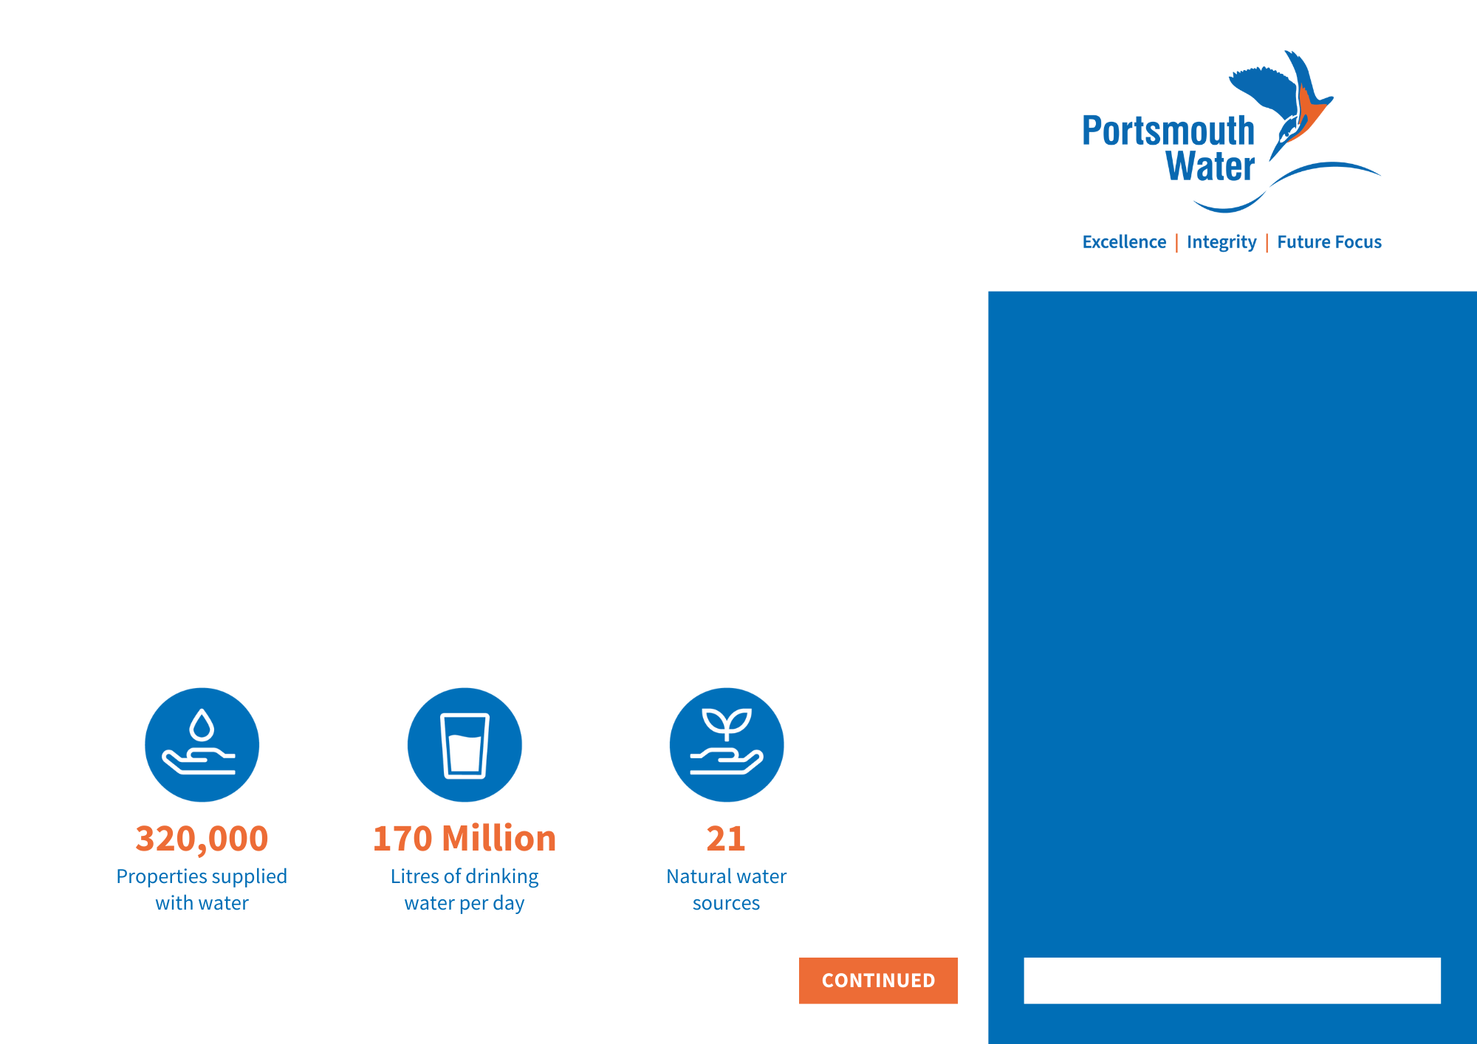
COMMUNICATIONS & ENGAGEMENT OFFICER – HAVANT THICKET
We’re making a difference: Together, we can ensure that there is enough water for everyone, now and in the future.
Are you an expert communicator with a flair for turning complex information into accessible copy? Do you enjoy forging excellent relationships with stakeholders, and getting involved with the detail behind event planning? If so, we would love to hear from you.
We're excited to be recruiting a new Communications and Engagement Officer, to join the team building Havant Thicket Reservoir – the first major UK reservoir to be constructed in over 30 years. Reporting to the Communications and Engagement Lead, you'll play a vital role in delivering aspects of the Communications Strategy for the project.
We're looking for a highly motivated, self-starter who can take ownership of a task and run with it. A key aspect of your role will involve driving a programme of site visits and meetings, both with members of the public, stakeholders and wider industry representatives, to showcase the work being undertaken, build confidence in the project and ensure the views and ideas of our community are incorporated wherever possible.
Your proactive monitoring of many of our channels will also mean you are often the first point of contact when one of our 70 stakeholders, or members of our community, has questions about the scheme.
What will you be doing?
Key Responsibilities
Taking ownership of key aspects of the Communications and Engagement Strategy for the project, to ensure high standards of delivery.
Leading on the organisation of a wide range of meetings and site visits. This will involve coordinating diaries, ensuring the correct people are in attendance, developing agendas, compiling slides and delivering presentations.
Proactively monitoring the dedicated Havant Thicket Reservoir inbox, responding to emails and escalating enquiries where appropriate.
Continued on page 2
£33,913- £37,561
GRADE 5
+ Non-contractual bonus related to company performance of up to 6% of basic salary
Hours:
Full-time | 38 hours per week | 3 days in the office | Occasional evening and weekend hours
Holiday:
25 days annual leave, plus bank holidays
Pension:
A generous pension scheme in which Portsmouth Water will contribute up to 15%
Enhanced Family Friendly Leave:
Enhanced Company maternity, adoption, and paternity leave and pay
Life assurance:
The life assurance scheme provides a death in service lump sum benefit of 4 times pensionable salary
Employee Assistance Programme:
Provided by Bupa
PW Perks: Access discounts at thousands of retailers, plus the Electric Vehicle Scheme, Cycle to Work Scheme, Health Cash Plan, and more!
CLOSING DATE: 24TH DECEMBER 2024

Slide 2
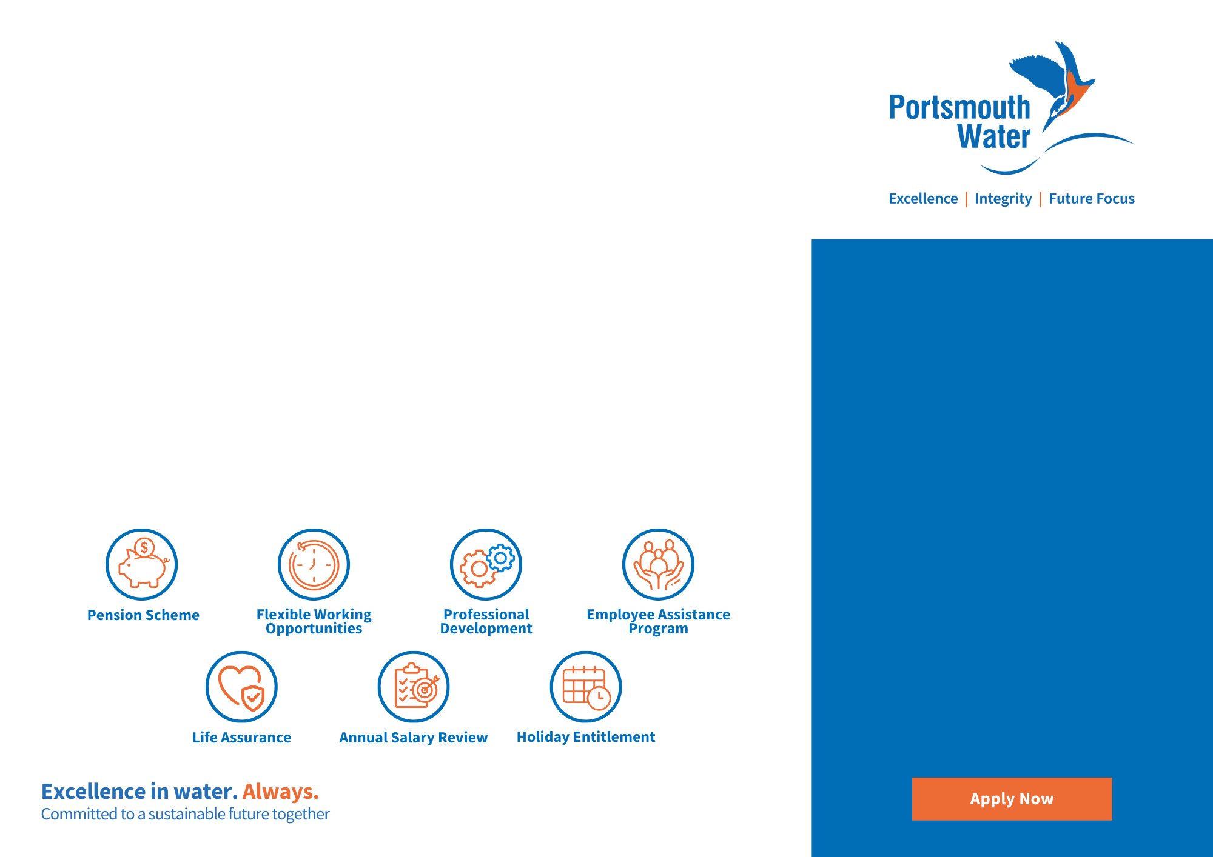
Key Responsibilities Continued
Proactively monitoring Portsmouth Water’s social media channels for comments and enquiries about Havant Thicket Reservoir and responding where appropriate.
Investigating and responding to enquiries about the Havant Thicket Reservoir project from members of our Stakeholder Advisory Group (made up of around 70 representatives from environmental, community and regulatory organisations) and from Portsmouth Water customers.
Writing for a range of audiences to a very high standard, this will include turning complex, technical information into accessible, accurate copy.
Logging all external contact about the project.
On an adhoc basis, this role may be required to support the communications and engagement function of the wider Portsmouth Water business.
What do you need?
Skills and Qualifications
A Bachelor’s degree in a relevant field (Communications, Journalism, English) is desirable but not essential.
Strong communication skills
Self-motivated, enthusiastic, and collaborative.
Excellent writing skills
Highly organised
Confident presenting to large groups.
Competent using Microsoft Excel and PowerPoint for tracking enquiries and creating presentations.
What can Portsmouth Water offer you?
Apply Today
If you have the skills and experience to excel as our Communications and Engagement Officer, apply today at jobs@portsmouthwater.co.uk
We recognise people want to work in a variety of different ways, this means we are happy to consider flexible working arrangements. Please talk to us at the interview about the flexibility you may want.
We support equality, diversity and inclusion and encourage applications from all sections of society. The Company has a responsibility to ensure that all employees are eligible to work and live in the UK.
Due to the high volume of applications received we are unable to respond to unsuccessful candidates. If your application is of interest to us, we will normally contact you within 4 weeks of receiving your application.
Apply Now

